Slide 1
AI, ML, DL, and GenAI
AI
Machine Learning
Deep Learning
GenAI
Rule-based systems (Expert systems) such as IBM Watson
Regression
Random Forest
SVM
Clustering
…
Feed-forward NN
Convolutional NN
Recurrent NN
…
LLMs
Diffusion
…
Notes:
AI, Machine Learning, Deep Learning, GenAI, LLMs… it’s easy to feel overwhelmed by the jargon. Let’s break it down.
As you can see in this Venn diagram, AI is the broadest concept. It refers to the development of systems that that perceive the world around them, generate a plan, and then make decisions to achieve their goals. Systems that perform tasks such as problem-solving, decision-making, language comprehension, and pattern recognition can all be considered forms of AI.
How to achieve AI?
Computer scientists typically use two primary approaches: rule-based systems and machine learning.
Rule-based system. A rule-based system uses a set of pre-written rules to solve problems and make decisions. They are often referred to as expert systems, as they operate based on a knowledge base crafted by human experts. These systems operate through numerous "if...then" statements, guiding the system’s responses based on specific conditions. For instance, IBM Watson was initially designed to assist with medical diagnoses by using a combination of rule-based algorithms and statistical approaches to provide recommendations based on structured data.
The second way to achieve AI is called Machine learning, which is a subfield of AI. Instead of using explicit rules, ML enables computers to learn patterns and make decisions based on large datasets. Here are some popular machine learning algorithms.
Deep Learning is a specialized subset of ML that uses artificial neural networks with multiple layers (recall the image you saw in the first slide)—hence the term “deep.” This approach enables the system to learn complex patterns in massive datasets, and it’s the core technology behind modern AI breakthroughs. Some popular deep learning algorithms are Convolutional neural networks used in computer vision, recurrent neural networks used in natural language process and so on.
Generative AI pushes deep learning further by using models capable of generating contents—whether that’s text, images, audio, and videos.
Large Language Models (LLMs) are examples of generative AI specifically designed to understand and generate human-like language. These models—like ChatGPT are powered by deep neural networks trained on diverse text data to predict and generate the next word in a sequence.
So, from rule-based systems to machine learning to deep learning, AI is a broad and diverse field. In this workshop series, we’ll focus on generative AI and LLMs to explore their impact on academia and education.
At this point, you might be wondering: How do machines learn? Or, what exactly are they learning? Is it the same as how humans learn? As educators, you might also be curious about how computer scientists train these systems. I’ll do my best to explain it in a way that’s easy to understand.

Slide 2
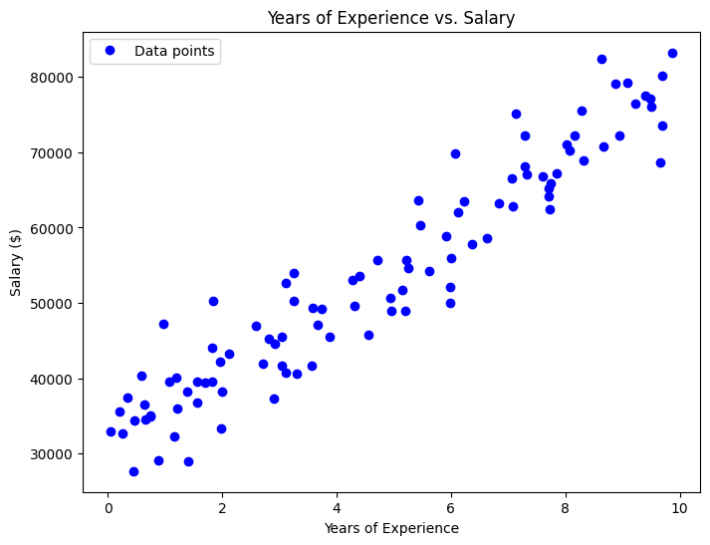
What Do Machines Learn?
Machine’s initial guess!
Index | Years of Experience | Salary ($)
1 | 3.75 | 9,162.24
2 | 9.51 | 76,040.68
3 | 7.32 | 67,058.50
4 | 5.99 | 49,995.08
5 | 1.56 | 36,702.57
6 | 1.56 | 39,585.29
7 | 0.58 | 40,293.65
8 | 8.66 | 70,717.46
9 | 6.01 | 56,013.28
 | … | …
5000 | 2.91 | 37,243.88
Notes:
Let me use a very simple machine learning algorithm called linear regression to explain what the machine really learns. No worries. There won’t be any mathematical equations.
Imagine you’re the machine. You’re presented with a list of people and two things you know about them:
Their years of experience, and
Their salary.
We would like the machine to learn a simple relationship between years of experience and salary. Well, by staring at the data, their relationship is not very obvious.
Here’s a visualization of that data.
Each blue dot represents a person’s salary based on their years of experience. As a human, you can easily see that in general, more experience tends to lead to a higher salary, the two things have a linear relationship. But the machine does not know that and it is trying to figure out how years of experience are related to salary. At the start, the machine has no clue, so it makes a wild guess, shown by this red line. It randomly thinks this is the relationship between experience and salary. But, as you can see, it’s not even close. It needs to learn.

Slide 3
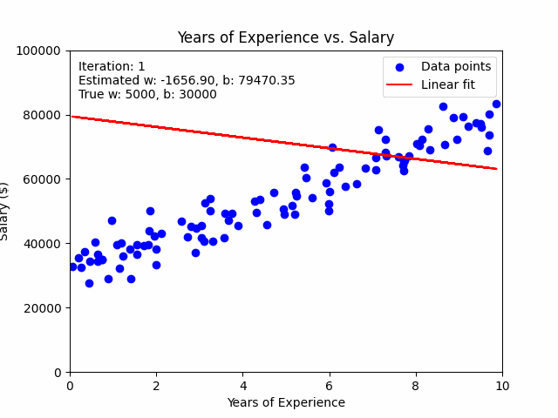
What Do Machines Learn?
Notes:
Here’s where the magic happens. The machine starts learning by adjusting its guess. With each adjustment or iteration, it compares the red line to the actual data (btw, we can the actual data the training dataset)—the blue dots—and asks itself, “How am I doing? How can I make my line fit the data better?” Oh, I should rotate the line counterclockwise, change it slope and move it down.
The line is controlled by two parameters: slope which is w and intercept which is b. As you can see, they are changing all the time.
It does this again and again, adjusting the line little by little. Each time, it reduces the gap between the predicted salary (the red line) and the actual salary (the blue dots).
After a lot of adjustments, the machine settles on the best-fit line. This red line represents the machine’s final understanding of the relationship between years of experience and salary.

Slide 4
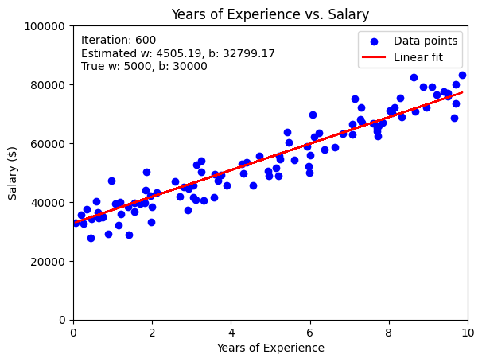
What Do Machines Learn?
Notes:
Now, when it sees someone with a certain number of years of experience, it can predict their salary based on what it has learned from the data.
So, what did the machine really learn? It learned the general trend or relationship between two things:
How much a person’s salary increases with every year of experience. That is the slope.
What the starting salary is for someone with zero years of experience. That is the intercept.
This is a basic but powerful idea in machine learning, where the goal is to uncover patterns in data. It starts off with a rough guess, learns from its mistakes, and improves its predictions step by step.
We’ve already seen how a machine can learn the relationship between years of experience and salary. But in reality, salary is influenced by many factors, not just experience. For example, someone with a higher education level—like a Master’s degree or a PhD—may earn more even if they have the same years of experience as someone else.
------------------------------------------
Let’s start with something we’ve already looked at—linear regression. The machine learns a simple relationship between two things: years of experience and salary.
In our earlier demo, the machine learned to find a line, which has two main parts:
A slope (how much salary increases for each additional year of experience), and
An intercept (the base salary when there’s zero experience).
This means the machine is learning two parameters: the slope and the intercept. Now, imagine we add a second variable, like education level. Suddenly, the machine isn’t just learning one relationship—it’s learning how two factors together affect salary. Instead of just one line, the machine now has to find a plane that best fits the data. And instead of learning just two parameters, it’s learning three parameters: the effect of years of experience, the effect of education level, and the base salary.

Slide 5
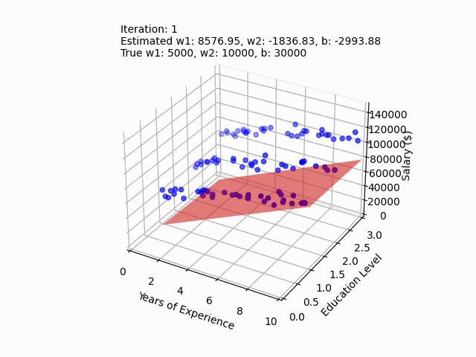
What Do Machines Learn?
Notes:
We’ve already seen how a machine can learn the relationship between years of experience and salary. But in reality, salary is influenced by many factors, not just experience. For example, someone with a higher education level—like a Master’s degree or a PhD—may earn more even if they have the same years of experience as someone else.
Now, let’s take a look at a more complex dataset. Here, we’re adding education level as a second factor. So, for each person, we know:
Their years of experience (just like before).
Their education level (Bachelor’s, Master’s, or PhD).
And their salary.
This time, the machine needs to learn how both experience and education together affect salary.
Just like before, the machine starts off with a completely random guess. But instead of just drawing a line, it now guesses a plane because there are two factors it’s trying to understand: years of experience and education level. This random plane is the machine's first attempt at connecting the dots between experience, education, and salary. But as we can see, this guess is way off.
Now, let’s watch how the machine learns. Just like before, it will adjust its guesses—this time by moving and tilting the plane—until it better fits the data. With each adjustment, it checks how well its current plane fits the actual data and then makes corrections. It slowly starts to learn how both experience and education affect salary.
After many adjustments, the machine finds the plane that best fits the data. Now, it understands the combined effect of years of experience and education level on salary.
This plane shows that:
For any given education level, salary increases with more experience.
And for any given experience level, higher education leads to higher salaries
So, what did the machine learn this time? It learned the combined effect of two factors:
How much salary increases with each additional year of experience.
And how salary also increases depending on the level of education (Bachelor’s, Master’s, or PhD).
By understanding both factors, the machine can now predict salary more accurately than if it had only looked at experience alone.
This is an example of how machines can learn from multiple variables at once. In this case, the machine didn’t just learn one relationship—it learned how two variables work together to affect salary. This idea—learning from multiple factors—is a key concept in machine learning. It helps machines make better, more accurate predictions, just like humans consider many factors when making decisions.

Slide 6
What Do Machines Learn?
Salary
Industry
Location
…
Education
Years of experience
Notes:
Now, let’s think bigger. Imagine we add even more features:
Maybe we add:
a person’s location.
Or their job title.
Or their industry.
And more.
With each new feature, the machine needs to learn a new relationship. And with each relationship, we introduce more parameters for the machine to learn. In this case, the machine is no longer just drawing a line or a plane—it’s fitting a higher-dimensional model. And it’s learning many parameters—one for each feature. Unfortunately, we can no longer visualize that high-dimensional space. Use your imagination!
Now let’s make a leap from salary prediction to something much more complex: language.
A model like ChatGPT, works in a similar way, but instead of predicting salary, it’s trying to predict the next word in a sentence.

Slide 7

Large Language Models
Forum Discussion
User1: Hey, can anyone recommend a good JavaScript framework for building a dynamic web app?
User2: I’d recommend React. It’s widely used, has great community support, and is perfect for building fast, interactive user interfaces. If you’re looking for something more lightweight, you might want to check out Vue.js as well.
User3: I agree with User2. React is awesome for component-based development, but Vue is a bit easier for beginners in my experience.
Wikipedia Article
Albert Einstein was a theoretical physicist who developed the theory of relativity, one of the two pillars of modern physics (alongside quantum mechanics). His work is also known for its influence on the philosophy of science. He is best known to the general public for his mass–energy equivalence formula E = mc², which has been dubbed "the world's most famous equation."
News Article
Global climate change continues to have a profound impact on ecosystems worldwide. Scientists warn that rising temperatures and increased frequency of extreme weather events could result in severe consequences for biodiversity. Governments around the world are working to implement policies aimed at mitigating the worst effects of climate change by reducing carbon emissions and encouraging the use of renewable energy.
How-Tos, Tutorials
How to Bake a Perfect Chocolate Cake:
1. Preheat your oven to 350°F (175°C).
2. In a large bowl, combine 2 cups of flour, 1 and a half cups of sugar, and a pinch of salt.
3. Add 1 cup of melted butter and 2 beaten eggs, then stir until smooth.
4. Pour the batter into a greased cake pan and bake for 30-35 minutes, or until a toothpick inserted in the center comes out clean.
Artificial Neural Network with 175 billion parameters
Notes:
Just like our linear regression model learns parameters for years of experience, education, and other factors, LLMs are learning relationships between words. But here’s the difference: instead of just a few parameters, an LLM, for example an early version of ChatGPT has to learn 175 billion parameters. That explains the first L in LLM: Large.
Why does ChatGPT need 175 billion parameters? It’s because language is incredibly complex. Think about all the nuances in language:
The same word can have different meanings depending on context.
Different sentence structures convey different emotions or intents.
Idioms, sarcasm, and tone all require understanding beyond just word definitions.
To learn all these relationships and nuances, the machine needs a vast number of parameters. Each parameter helps the model get better at understanding and predicting language. Think of each parameter as a brain cell.
Here is a general rule of thumb: The more parameters a model has, the more intelligent it might be. Of course, the more expensive the training is.
What about the training data? ChatGPT learns from a massive text dataset scraped from the Internet. For example, Wikipedia articles……
-----------------------------------------
Llama 3.2: 1B, 3B, 11B or 90B model.
But if you’ve played with OpenAI’s ChatGPT, you know that it produces many tokens, not just a single token. That’s because this basic idea is applied in an expanding-window pattern. You give it n tokens in, it produces one token out, then it incorporates that output token as part of the input of the next iteration, produces a new token out, and so on. This pattern keeps repeating until a stopping condition is reached, indicating that it finished generating all the text you need.
-------------------------------------------------------
the “attention mechanism,” which allows the model to pay more attention to some inputs than others, regardless of where they show up in the input sequence. For example, let’s consider the following sentence: She wen to the store and …: In this scenario, when the model is predicting the verb “bought,” it needs to match the past tense of the verb “went.” In order to do that, it has to pay a lot of attention to the token “went.” In fact, it may pay more attention to the token “went” than to the token “and,” despite the fact that “went” appears much earlier in the input sequence.
While playing with ChatGPT, you may also have noticed that the model is not deterministic: if you ask it the exact same question twice, you’ll likely get two different answers. That’s because the model doesn’t actually produce a single predicted token; instead it returns a probability distribution over all the possible tokens. In other words, it returns a vector in which each entry expresses the probability of a particular token being chosen. The model then samples from that distribution to generate the output token.
How does the model come up with that probability distribution? That’s what the training phase is for. During training, the model is exposed to a lot of text, and its weights are tuned to predict good probability distributions, given a sequence of input tokens. GPT models are trained with a large portion of the internet, so their predictions reflect a mix of the information they’ve seen.

Slide 8
Large Language Models
Academic Paper
This paper investigates the impact of quantum computing on cryptography. With the advent of powerful quantum computers, traditional encryption methods such as RSA and ECC are becoming vulnerable to attacks using Shor’s algorithm. We propose a quantum-resistant cryptographic scheme based on lattice-based cryptography, which is believed to be secure against quantum attacks. Our experimental results demonstrate the feasibility of implementing such systems on modern hardware.
Code Snippet
def fibonacci(n):
if n <= 0:
return "Invalid input"
elif n == 1:
return 0
elif n == 2:
return 1
else:
a, b = 0, 1
for i in range(2, n):
a, b = b, a + b
return b
Social Media Post
Just had the best coffee of my life at this cute little cafe downtown. Highly recommend if you’re in the area! #coffee #cafelife ☕
Artificial Neural Network with 175 billion parameters
Notes:
When ChatGPT is trained, it learns to recognize patterns in massive amounts of text.
These patterns include:
How words relate to each other in a sentence.
How grammar structures sentences.
How context changes the meaning of words.
And so on.
Every parameter ChatGPT learns helps it understand how words and phrases fit together. Each parameter is like a tiny adjustment that improves the model’s ability to predict the next word in a sentence based on all the words that came before it.

Slide 9
LLM Is a Next Word Predictor
The quick brown fox jumps
Notes:
Once ChatGPT has learned these parameters, it can apply them to generate human-like text. Just like our salary prediction model can predict a salary based on experience and education, ChatGPT can predict the next word in a sentence based on everything that came before. And because it has learned so many parameters, it can generate text that’s incredibly fluent and coherent.
An LLM is nothing but a Next Word Predictor!
Given an input like, “The quick brown fox jumps,” this called a prompt. ChatGPT will predict the next word based on this prompt.

Slide 10
LLM Is a Next Word Predictor
The quick brown fox jumps over
Notes:
In this case, it predicts “over”. Then it incorporates that output word as part of the input of the next prediction, produces a new word out, and so on.
This pattern keeps repeating until a stopping condition is reached, indicating that it finished generating all the text you need.

Slide 11
LLM Is a Next Word Predictor
The quick brown fox jumps over

Slide 12
LLM Is a Next Word Predictor
The quick brown fox jumps over the

Slide 13
LLM Is a Next Word Predictor
The quick brown fox jumps over the

Slide 14
LLM Is a Next Word Predictor
The quick brown fox jumps over the lazy

Slide 15
LLM Is a Next Word Predictor
The quick brown fox jumps over the lazy

Slide 16
LLM Is a Next Word Predictor
The quick brown fox jumps over the lazy dog

Slide 17
LLM Is a Next Word Predictor
The quick brown fox jumps over the lazy dog

Slide 18
LLM Is a Next Word Predictor
The quick brown fox jumps over the lazy dog to

Slide 19
LLM Is a Next Word Predictor
The quick brown fox jumps over the lazy dog to

Slide 20
LLM Is a Next Word Predictor
The quick brown fox jumps over the lazy dog to catch

Slide 21
LLM Is a Next Word Predictor
The quick brown fox jumps over the lazy dog to catch

Slide 22
LLM Is a Next Word Predictor
The quick brown fox jumps over the lazy dog to catch a

Slide 23
LLM Is a Next Word Predictor
The quick brown fox jumps over the lazy dog to catch a

Slide 24
LLM Is a Next Word Predictor
The quick brown fox jumps over the lazy dog to catch a _____

Slide 25
LLM Is a Next Word Predictor
Probability
rabbit
chicken
fish
The quick brown fox jumps over the lazy dog to catch a _____
cold
Notes:
How does ChatGPT predict the next word? Given the input, “The quick brown fox jumps over the lazy dog to catch a ” ChatGPT computes a probability distribution over all the possible words in its discretionary. ChatGPT then samples from that distribution to generate the output word. While playing with ChatGPT, you may have noticed that the model is not deterministic: if you ask it the exact same question twice, you’ll likely get two different answers. That’s because the model samples from that distribution to generate the output word.

Slide 26
LLM Pays Attention to the Context When Predicting the Next Word
Probability
rabbit
chicken
fish
The quick brown fox jumps over the lazy dog to catch a _____
cold
Notes:
How does ChatGPT predict the next word? Given the input, “The quick brown fox jumps over the lazy dog to catch a ” ChatGPT computes a probability distribution over all the possible words in its discretionary. ChatGPT then samples from that distribution to generate the output word. While playing with ChatGPT, you may have noticed that the model is not deterministic: if you ask it the exact same question twice, you’ll likely get two different answers. That’s because the model samples from that distribution to generate the output word.

Slide 27
LLM Pays Attention to the Context When Predicting the Next Word
Probability
rabbit
chicken
The quick brown fox jumps over the lazy dog to catch a _____
fish
cold
Notes:
When computing the probability distribution, ChatGPT is using a mechanism called “attention.”
The “attention mechanism,” which allows the LLM to pay more attention to some inputs than others, regardless of where they show up in the input sequence. In this example, when the model is predicting the word after “catch a” it pays a lot of attention to the word “fox” than to the word “over,” despite the fact that “fox” appears earlier in the input sequence.
-----------------------------------------------
How does the model come up with that probability distribution? That’s what the pre-training phase is for. During pre-training, the model is exposed to a lot of text from the internet, and its weights are tuned to predict good probability distributions, given a sequence of input tokens. GPT models are trained with a large portion of the internet, so their predictions reflect a mix of the information they’ve seen.

Slide 28
LLM Produces a Stop Word
The quick brown fox jumps over the lazy dog to catch a rabbit.
Notes:
Stop word.

Slide 29
Key Takeaways
Parameters are the building blocks: Start with simple parameters in linear regression and expand to billions in LLMs.
Learning patterns: Whether predicting salary or the next word in a sentence, the machine is learning relationships between data points.
Complexity grows with more parameters: LLM’s power comes from learning patterns on a massive scale.

Slide 30

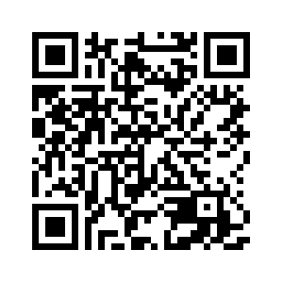
Email:
  b.wei@tcu.edu
AI for Everyone:

