Slide 1
Haivision ViperMax
Quick Recording Guide

Slide 2
Table of Contents
Activate Room AV
Crestron Control Panel …………………………………..... 3
Microphone …………………………………………………. 4
ViperMax Recording (Quick Start)
Log In ………………………………………………………... 5
Defaults ……………………………………………………... 6
Metadata ……………………………………………………. 7
Recording ………………………………………………….. 10
Recording Setup
Reference when defaults are incorrect …………………. 12
Camera Remote
Vaddio Remote Quick Reference ………………………... 17

Slide 3
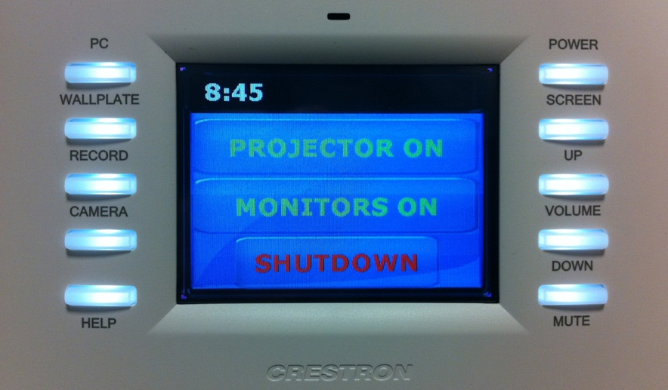
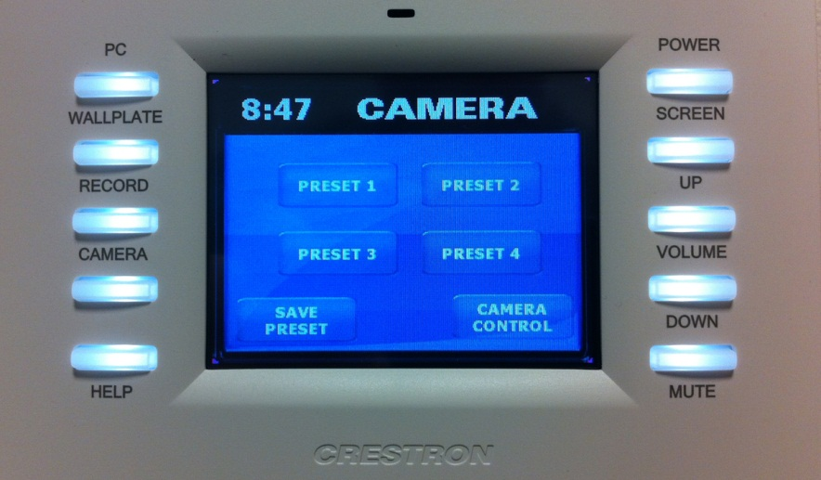
Activate Room A/V
Press Power
Press Monitors On
3. Press Camera
Select Preset 1
This will pan and focus the camera to the north wall centered on the whiteboard.
If camera is blurry: Use the Vaddio Remote in the cabinet and click the Auto Focus button.

Slide 4
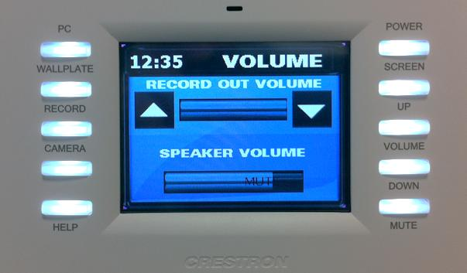
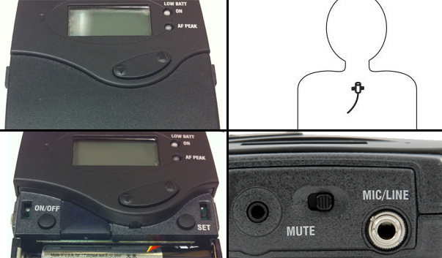
Activate Room A/V
Pinch to Open
Verify Recording Volume
Press touchscreen arrows to adjust
Verify Speaker Volume
Press physical buttons to adjust
3. Turn on Lavalier Microphone
Proper position is center of the body about one hand’s width below the chin.
Unmute the microphone (top center of transmitter, slide button away from the word MUTE)

Slide 5
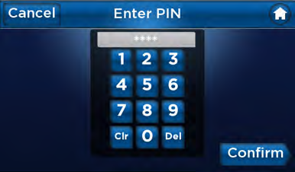
Recording Quick Start: Log In
Touch the screen
2. Enter PIN
Press Confirm

Slide 6
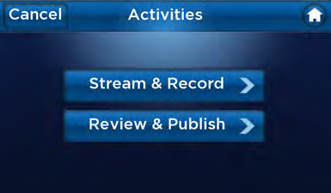
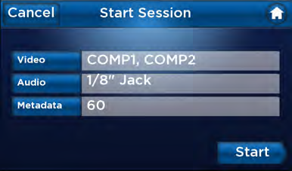
Recording Defaults
COMP2
RCA
60
Press Stream & Record
2. Press Start
If the screen does not read like this follow the steps in the Recording Setup.

Slide 7
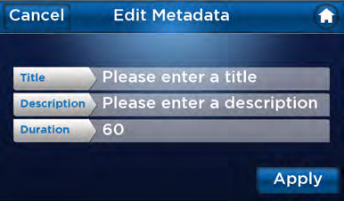
Recording Setup: Metadata
COMP2
Please enter a title
RCA
Please enter a description
60
60
1. Press Metadata
2. Press Title
Keyboard in the left cabinet can be used for typing once the Title/Description is selected.

Slide 8
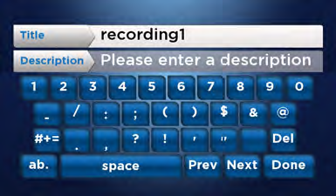
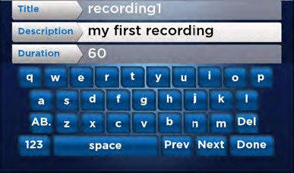
Recording Setup: Metadata
Smith
Smith
Sermon1
Please enter a description
60
3. Enter “LastName”
Click DONE
4. Press Description
Enter “Sermon#”
Press DONE
5. Leave Duration
Manually ending the recording will override this number

Slide 9
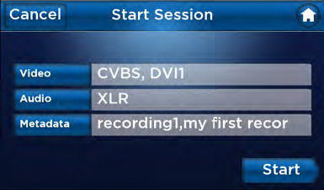
Recording Setup: Metadata
Smith
COMP2
Sermon1
RCA
60
Smith,Sermon1
6. Press Apply
7. Press Start
This will take you to the Recording screen

Slide 10
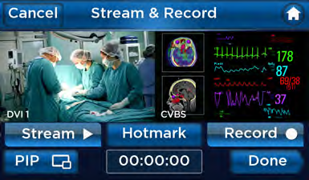
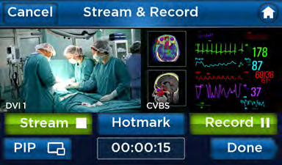
Recording
Press Record
The Record button turns green to indicate that the appliance is actively recording, and the counter starts counting
2. Press Done
To end the recording and publish the video asset.

Slide 11
Stop
The following slides are for reference should the ViperMax lose the default settings from page 5.

Slide 12
Recording Setup: Video Use these steps if the defaults in previous slide appear incorrect
Press Stream & Record
2. Press Video

Slide 13
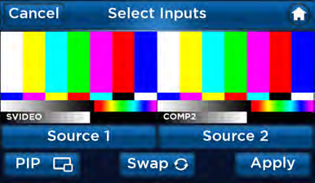
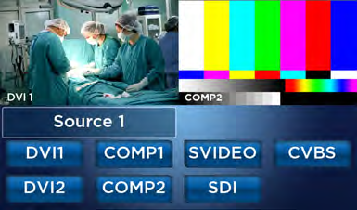
Recording Setup: Video
3. Press Source 1
4. Press COMP2

Slide 14
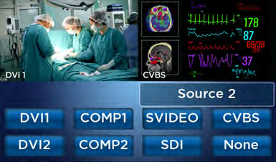
Recording Setup: Video
5. Press Source 2
6. Press None

Slide 15
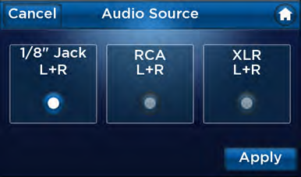
Recording Setup: Audio
1. Press Audio
2. Press RCA
3. Press Apply

Slide 16
Recording Setup Completed
Session settings should appear like above.
Return to page 6 for Metadata Setup

Slide 17
Vaddio Remote
Power
Controlled by Crestron touch panel
Camera Control
Pan
Tilt
Zoom
Presets
1-Captures north wall and presenter from head to toe
2-Captures the whiteboard area

