Slide 1

Notes:
Presented to: Dr. Cohen’s Leadership students

Slide 2
PowerPoint
Presentation
PowerPoint
Presentation
Presentation Posters
  Loren D. J. Baxter, Center for Instructional Services, 817-257-6131
  8/25/2011
Notes:
Thank you for the introduction, Dr. Cohen.
I am Loren Baxter, I serve TCU through the Center for Instructional Services by assisting in the development of creative, instructional graphics and presentation resources.
Welcome to Presentation Posters.
This class is a low-pressure learning experience – with this in mind, I want to remind you of a few details that are helpful for our group experience.

Slide 3
Learning Expectation
Questions lead us to new understandings
“Every clarification breeds new questions.”
Arthur Bloch
Notes:
Every question is important.
There is almost always an answer. Quite often the answer comes with knowing the most appropriate terms to use in the question. When you seek help (F1) beyond this presentation, remember to explore different terms that might be associated with your question. Each academic discipline incorporates technical terms, correlating our meaning with the proper term can be a challenge.
As adult learners, we have unique learning styles. Some of us will identify with this presentation, it’s color, format, attitude or font. And others may already be distracted.
Technology makes many routine activities easier, and occasionally more complex as it transforms our teaching and learning.
Knowledge limitations. We may not be able to answer every question. My commitment to you is that we will find an answer for every question you ask about PowerPoint, even if the answer is no, the software can’t do that.

Slide 4
What is PowerPoint?
Digital Presentation Software
  Static
  Dynamic
  Interactive
  Multimedia
  Hyperlinks
Notes:
PowerPoint is digital presentation software that can be used as a tool for sharing information. Think of it as overhead transparencies … with a little bit of BAM!
The information you choose to share might relate to sales, demographic trends, political statistics, departmental reports, professional conferences and classroom education.

Slide 5
Why PowerPoint?
Industry Standard
  Universal
  Mac and PC
Communication
    Research (e.g. Poster Presentation)
    Data/Statistics
    Pictures
    Reports
Notes:
Why use PowerPoint?
PowerPoint is industry-standard presentation software used in education, business, research and professional facilities both nationally and world-wide.
Every PC running Windows is capable of presenting a basic PowerPoint Show, the PowerPoint Player is part of the operating system.
PowerPoint is available for Mac and PC.
When should we use something else?
When the audience, content or location requires another approach. (e.g. A video production/Flash animation instead of a PowerPoint)
Communication is at the core of every presentation, written, oral or visual.
PowerPoint is a tool that can help your presentations become more visually interesting and effective - regardless of the topic. Today you will leave class with new or revised skills in creating an effective digital presentation.

Slide 6
Introduction
We will learn …
  The essential components of an appropriate presentation/research poster
  Color, Fonts, and WordArt choices
  Design Themes
Notes:
Goals*
After participating in this presentation you will be able to:
Navigate and edit in the PowerPoint windows.
Design an audience-content-location specific presentation.
Use fonts, color, artwork, and imagery effectively.
Apply a design template.
Apply Animation templates.
Identify resources for expanding your PowerPoint knowledge.
*Accessed and modified 03/17/08 from http://office.microsoft.com/training/training.aspx?AssetID=RC011298761033

Slide 7
Audience/Content/Location
Or if you would prefer to ask …
  For whom?
  What?
  When?
  Where?
  Why?
  How?
Notes:
Defining three factors will influence the effectiveness presentation. Audience, Content, and Location.
Audience,
The undergraduate will have different learning expectations from a professional conferee.
When in doubt – meet your professor’s expectations.
Content,
Depth and topic will inform the presentation design, style, and complexity.
e.g. A PowerPoint about photography will likely contain photographs.
Location,
What equipment is available?
Will I be able to use my own equipment?
What is the room like? Seating, lighting, acoustics?
Design your presentation with these three things in mind and you will have the framework for a PowerPoint that will complement the information.
Key:
Preparation – Be ready, be rested, be confident – your information is worth sharing with enthusiasm!

Slide 8
Design Principles
Contrast
Color
Fonts
Artwork
Notes:
Sound Design principles are where effective visual presentations begin.
They include the concepts of
Contrast
Color
Fonts
Artwork
Clip Art
Photographs
Media
When each concept is implemented well the presentation will have the same level of cohesion as your physical, mental, and oral components.

Slide 9
Contrast
Projected Presentations
  Dark background, light text
Printed Presentations
  Light background, dark text
    TCU Purple: R79 G45 B127
Notes:
Projected Presentations: Dark background, lighter text
Printed Presentations: Lighter background, darker text (Judgment call on overhead transparencies)

Slide 10
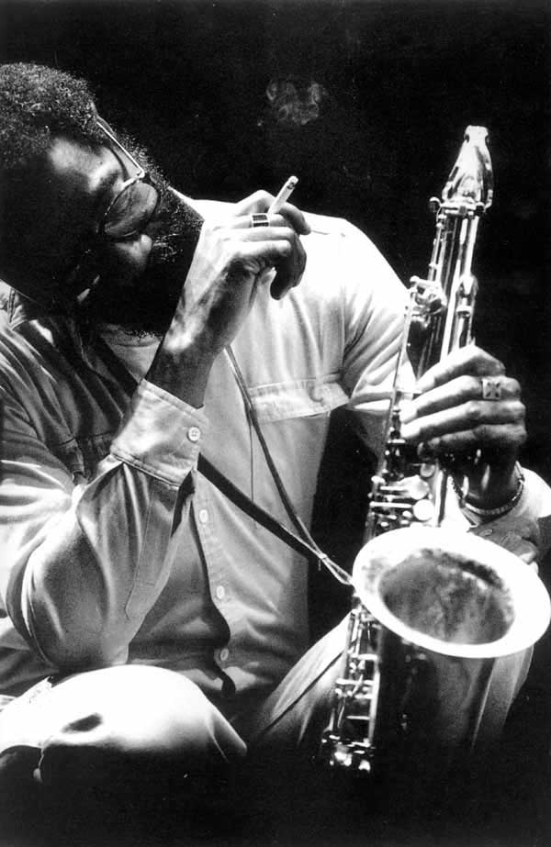


Color
Simple Palette
  Complimentary
  Appropriate
Printed Handouts
  Black and White
  Grayscale
Notes:
The Colors you choose will impact the attitude how your information is seen and how it is felt.
Use complimentary colors
While the Green and Yellow may work well together in some situations, the text does not.
Use colors that are appropriate
Logos (UT Orange used to talk about TCU Baseball?)
Handouts need to be in black and white or grayscale
Charts, graphs, and diagrams should be reviewed to ensure legibility

Slide 11
Fonts
One or Two Families
  Tahoma, Tahoma Italic, Tahoma Bold
  Arial, Arial Italic, Arial Bold
  Times New Roman, Italic, Bold
Minimum Size 24 Points
  This line is 24 point Tahoma
  and then 24 point Times New Roman
  and 18 point Times New Roman
Notes:
Minimize the number of fonts used, stick to one or two families
Maximize the font size

Slide 12
Fonts
Display
  Sanserif Font
  Two to five words
Body Copy (Content)
  Sanserif Font (PPT)
  Serif Font (Printed)
Underline
Notes:
Display Font – Large Information – subject headings
Easy to read
Two or three words
No feet - sanserif
Body Copy – Details – content, charts, and graphs
Think “newspaper” but much bigger
Smooth reading of paragraphs – posters can be free of complete paragraphs – put the paragraphs in your mind!
Recent thought suggests removing underlining from digital presentations – can you guess why? (seen as hyperlinks) Find another way to bring emphasis if emphasis is the intent with underlining.

Slide 13

Notes:
This poster presented some very good information. As you can see it is somewhat difficult to read, even projected.
What does it “feel” like? (overwhelming amount of information to read, well-organized, consistent font and sizes)
Would you stop to read it? (It might be approachable if the title catches one’s eye. Otherwise perhaps not.)
What is your feedback based on what we have learned so far about contrast, color and fonts?
Will it make a good printed poster? Why?
Now let’s see how it “feels” with some fine-tuning.
* None of this research was completed by Loren Baxter, the name was changed for the sake of this presentation.

Slide 14

Notes:
What I did to make this presentation more approachable and legible from a distance:
Made statements more concise.
Adjusted bullet point indents to create an easier read and more negative space.
Broke an entire paragraph into bullet points and created another subhead (Treatment Areas).
Adjusted the charts and graphs to contain colors similar to the background.
Decreased the size of references, adjusted formatting to the correct style (Chicago, I believe).
Increased the size of font within Discussion and Conclusion.

Slide 15

WordArt
Be Consistent
  Color
  Font
  Size
  Position
WordArt
WordArt
WordArt
WordArt
Notes:
Artwork
Clip Art
Photographs
Media

Slide 16

Notes:
In this example WordArt used is similar for a majority of the headings and subheadings.
Pros: Colors of WordArt “Subheadings” contain the same gradient. Flags appear to be good quality art.
Improvements: At least seven different fonts and colors were chosen – select one. Artwork seems more random than intentional.
Where is your eye drawn?
What are you interested in reading about?

Slide 17
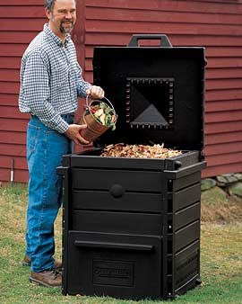
Clip Art / Photographs
Be Consistent
  Style
  Size
  Position
Photos
  Size Ratio
  1200 pixels
  Citation
Photo courtesy http://www.recycling-revolution.com/compost-bins.html. Accessed 11/15/07.
Notes:
Clip Art
Use similar styles of clip art
Let it reflect the attitude if the Audience and Content
Art should draw positive attention to the slide or an area of the slide
Photographs
Maintain an even ratio of width to height
The best pictures are always used at 100% or smaller
If another person’s photograph is used – cite them on the slide or in the References (use proper style in academic realm)
Now that we have some sound design concepts understood I need to introduce you to the PowerPoint one-step solution for designs that work right from the beginning.

Slide 18
Design Styles
Design Themes – in the ribbon
  Slide Design
  Slide Design – Color Scheme

Slide 19
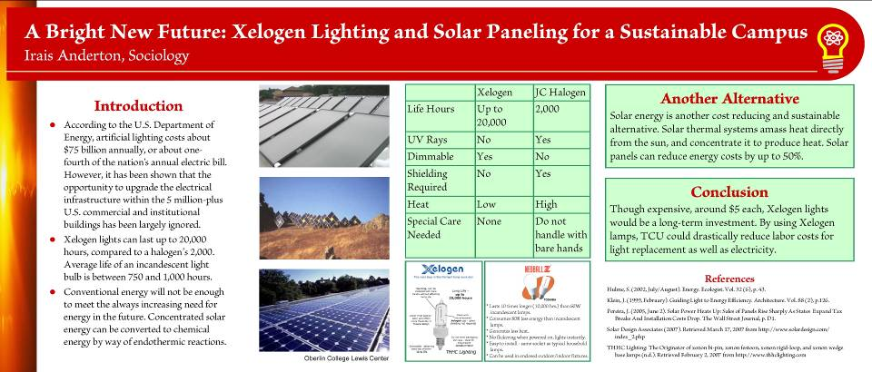
Notes:
The most important information on this poster was easily read from 10 feet away.
They used consistent fonts (large enough for reading at a distance), consistent font size, with concise statements. Appropriate photographs (cited too), tables, and references were also helpful.

Slide 20
Supplements
Take a Memory
Printed Handouts – Summary Information
Print Notes Pages
Notes:
Give your guest something they can take away from the experience – something tangible, a mint, apple, fun size candy, etc. Give something special for the person who asks a great question that may lead you to more research (as a way to say thank you)?
Ensure printed handouts are legible, can be smaller (½ page) – kick supplements up a notch by incorporating the same style/font as your poster – now that would be consistency!
Use notes pages for your bibliography – then print one out for easy reference at the presentation.

Slide 21
Multimedia
Audio
Video
Hyperlinks
Notes:
Multimedia in a Presentation Poster? How can that be?
The first aspect is presentation, at some point you will be standing with your poster – this is a great time to bring in multimedia.
Adding multimedia components will add additional depth to a PowerPoint
Used to add emphasis to a point or illustrate an concept from pop culture or recent news.
Run a special video file from a laptop/iPad/iPhone while you are standing with your poster.
Hyperlinks are helpful for streamlining your content
Hyperlinks takes you away from the presentation – use Alt+Tab to navigate back successfully and quickly
Practice, practice, practice – Make sure everything works at the presentation site.

Slide 22
Cost and Lead Time
Templates
Cost is based on materials recovery
  Check
  Cash
Lead Time: Three to five business days
Notes:
Clicking Templates takes you straight to the CIS website (broken link, link has been removed)
We charge $XX.00 per square foot for printing.
Lamination:
$.XX / linear foot for posters with a short edge of 24”
$XX.00 / linear foot for posters up to 42” in width or height

Slide 23
Conclusion
Clean, easy to read, and easy to see.
Graphics, art and other media for emphasis.
Plan, prepare and practice.
Notes:
Conclusion
PowerPoint Presentation Posters can be made really simple or exceedingly complex – neither determines the effectiveness of your presentation.
Posters become assets that illuminate the topic in a way that is appropriate to the audience and content.
Time, facility, equipment and audience should dictate the level of complexity you need in your poster.
If you are standing with your poster – you are part of the presentation! Be well-rested, sharply dressed and ready to answer questions.
You already know the importance of planning, preparing and practicing – using these principles - together with presentation software like PowerPoint will make your poster presentations more effective. Do you want to know how effective? Ask someone for feedback or what they understood most clearly or less clearly.
Thank you for listening, are there any questions?

Slide 24
Resources
More PowerPointers ...
  Microsoft Office PowerPoint Help
  (F1 then enter a search term)
  TCU Related
    http://www.ic.tcu.edu/writing/stu_graphics.asp
  Other resources
    http://www.abitbetter.com/powertips.htm
    http://www.actden.com/pp/
    http://www.rdpslides.com/pptools/
    http://www.soniacoleman.com/Tutorials/tutorials.htm

Slide 25
Resources
Science-related resources
  http://www.swarthmore.edu/NatSci/cpurrin1/posteradvice.htm
  http://www.writing.engr.psu.edu/posters.html
  http://www.ncsu.edu/project/posters/NewSite/Resources.html - University level scientific posters, samples, good bibliography.
  http://www.posterpresentations.com/html/free_poster_templates.html - Downloadable templates
  http://www.the-aps.org/careers/careers1/GradProf/gposter.htm - Presentation and research posters from the American Physiological Society.
  http://www.kumc.edu/SAH/OTEd/jradel/Poster_Presentations/PstrStart.html - Html-based tutorial developed by a University of Kansas Professor.
  http://www.jyi.org/SCC/Article.php?articleNum=106 – Content to include
  http://www.biophysics.org/education/block.pdf - Do’s and Don’ts with rationale.
    http://www.sciencepresentations.com/ - Pay site
    http://phdposters.com/ - Pay site

Slide 26
Created by Loren D. J. Baxter,
© 2009. Media Production Support Services, Center for Instructional Services, Texas Christian University
817-257-6131 (Chastity Beene is the current contact at this number)

