Slide 1
Geographical Approach to the Economy
CH 1 – Content Modules

Slide 2
Geography
‘To write about the earth’
The study of place and space
Studies the location and distribution of features on the earth’s surface
Studies human activity, the natural environment, and the relationship between the two
Answers where? and why?

Slide 3
1.1 How do we think spatially?
The top learning objective for this course is that everyone enrolled finishes with a well-developed ability to think geographically/spatially. Doing this requires being able to answer four related questions, each of which highlights a particular conceptual tool that geographers use to understand activities on earth.
How are activities distributed across space?
(Space)
How do the unique features of specific places shape the form of the activities we are studying?
(Place)
How are activities connected across space so that what happens in one place can profoundly affect what happens in another place?
(Networks)
How does power over space, especially in the form of government or other social controls, influence activities in process, and the potential activities that could occur within particular places/spaces?
(Territory/Production of Space)

Slide 4
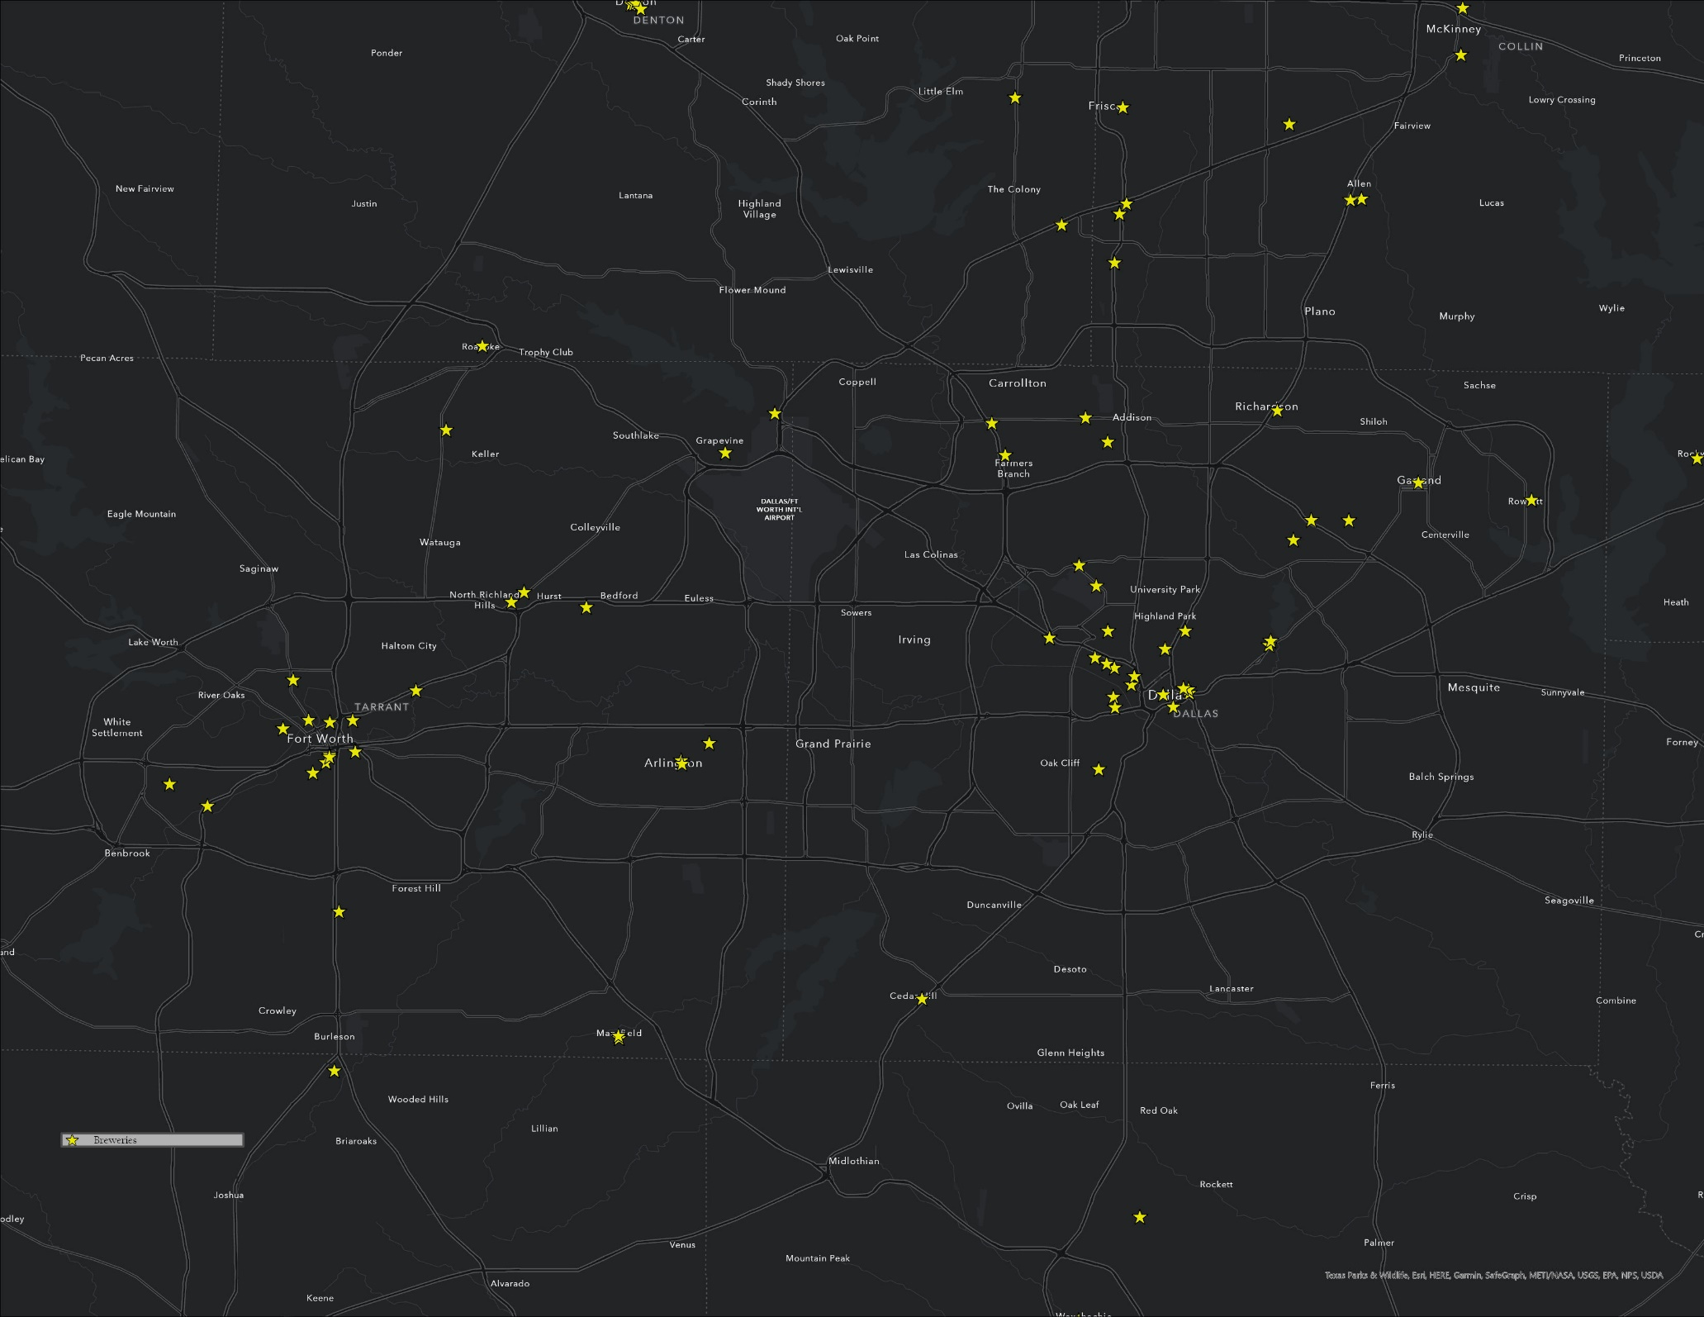

Slide 5
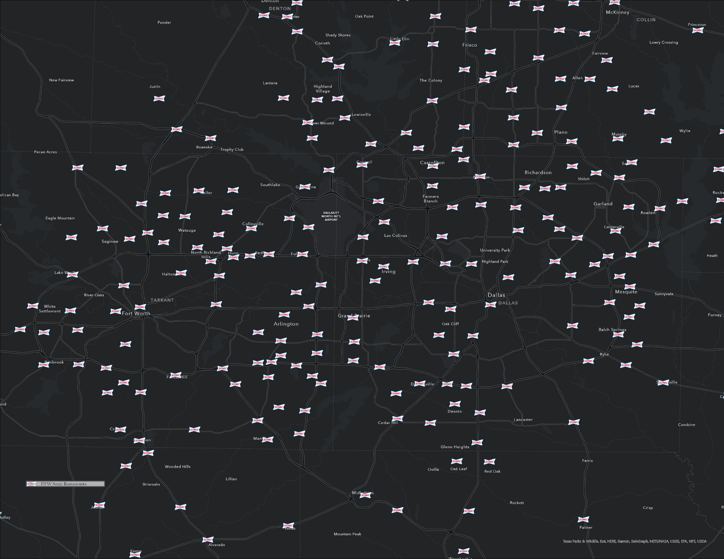

Slide 6
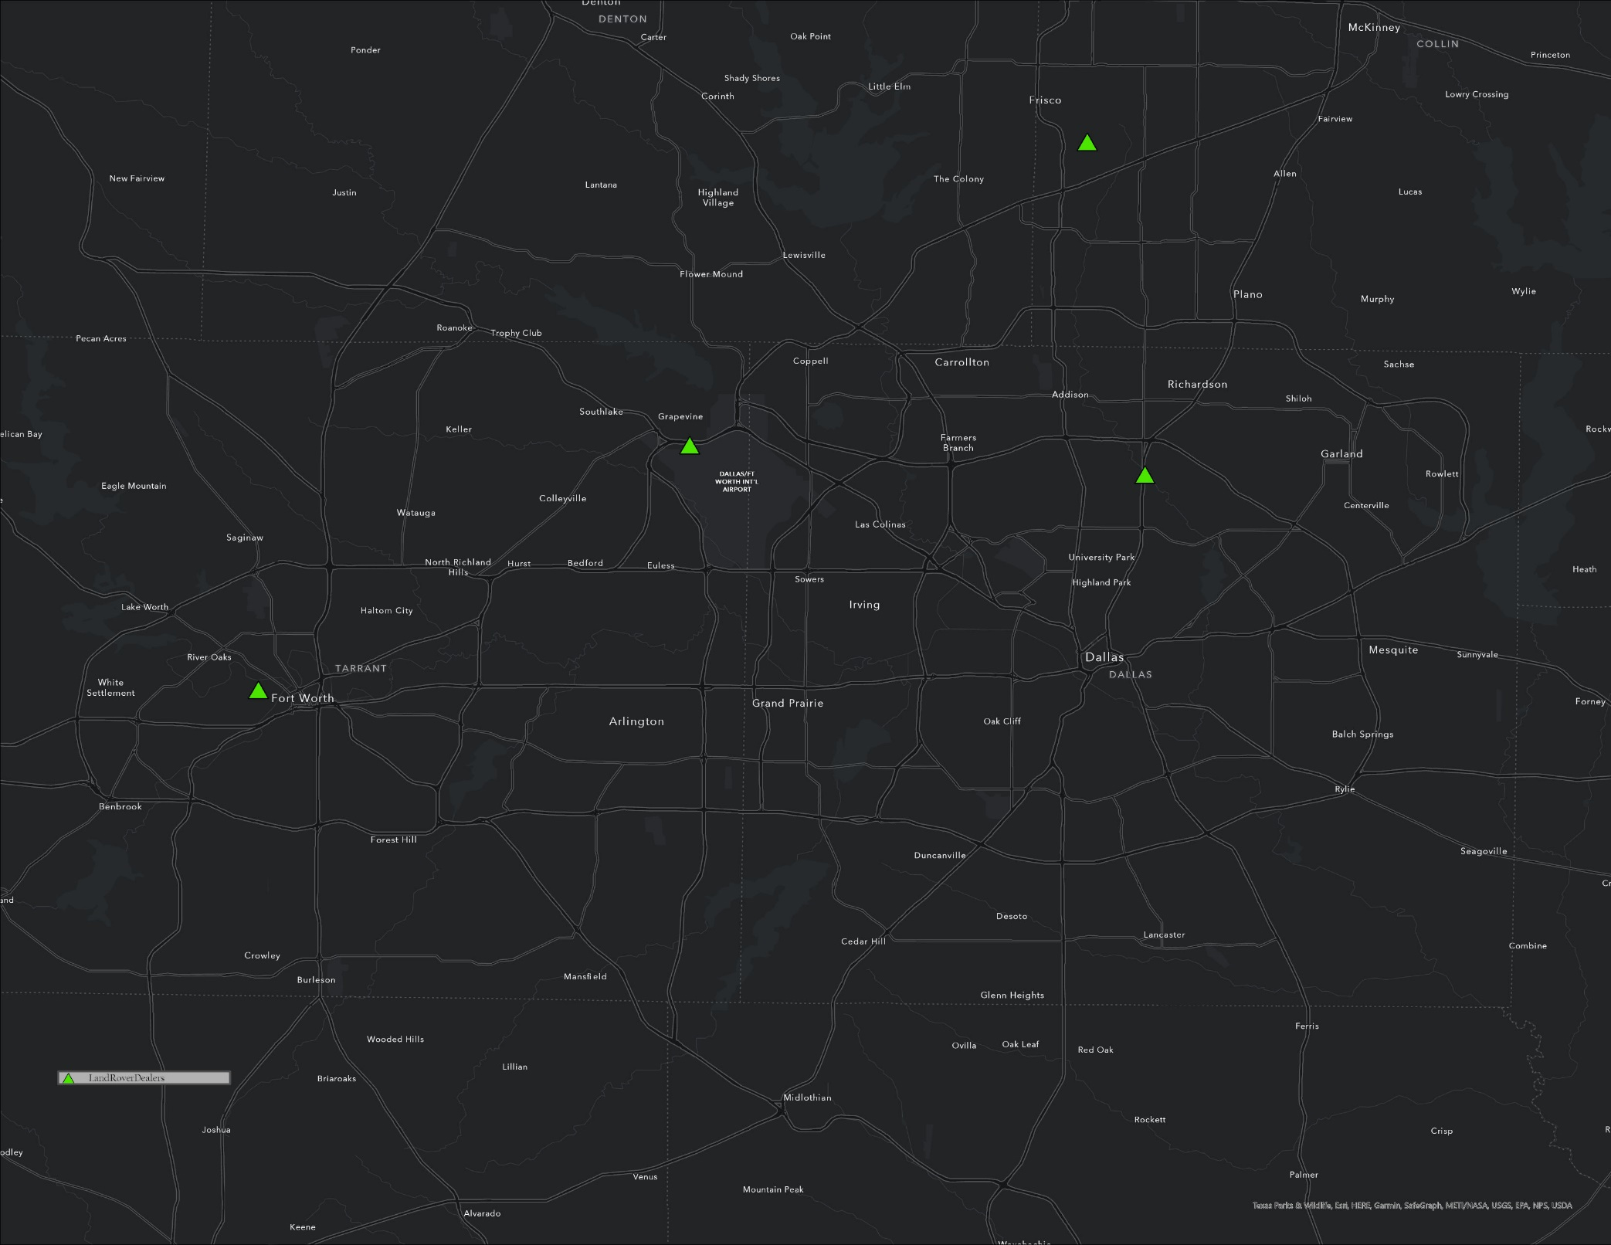

Slide 7
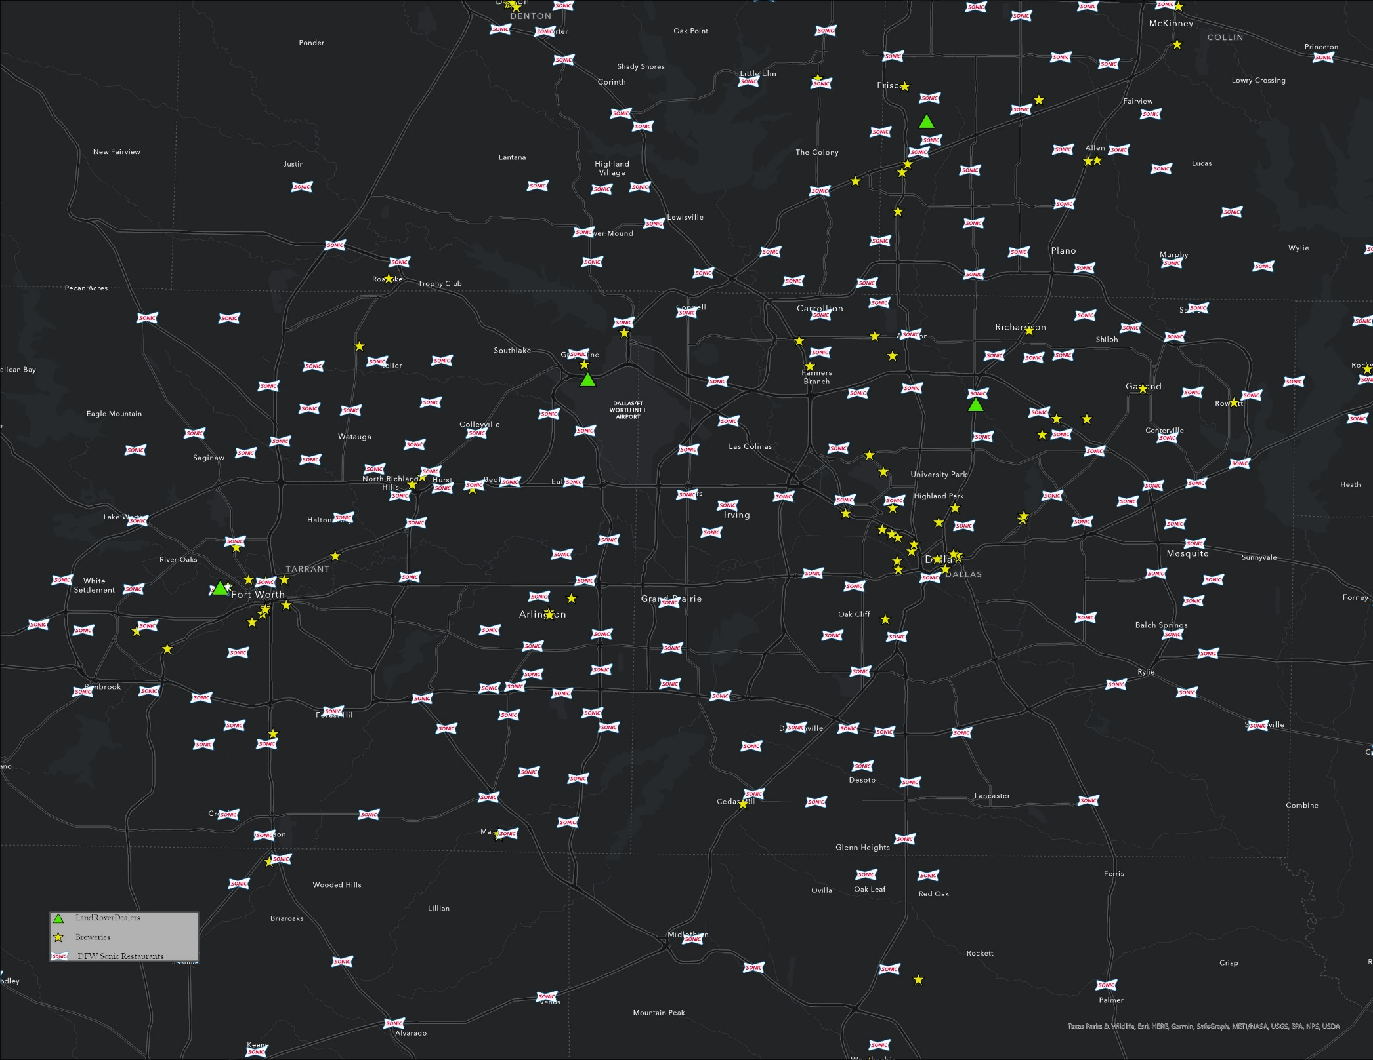

Slide 8
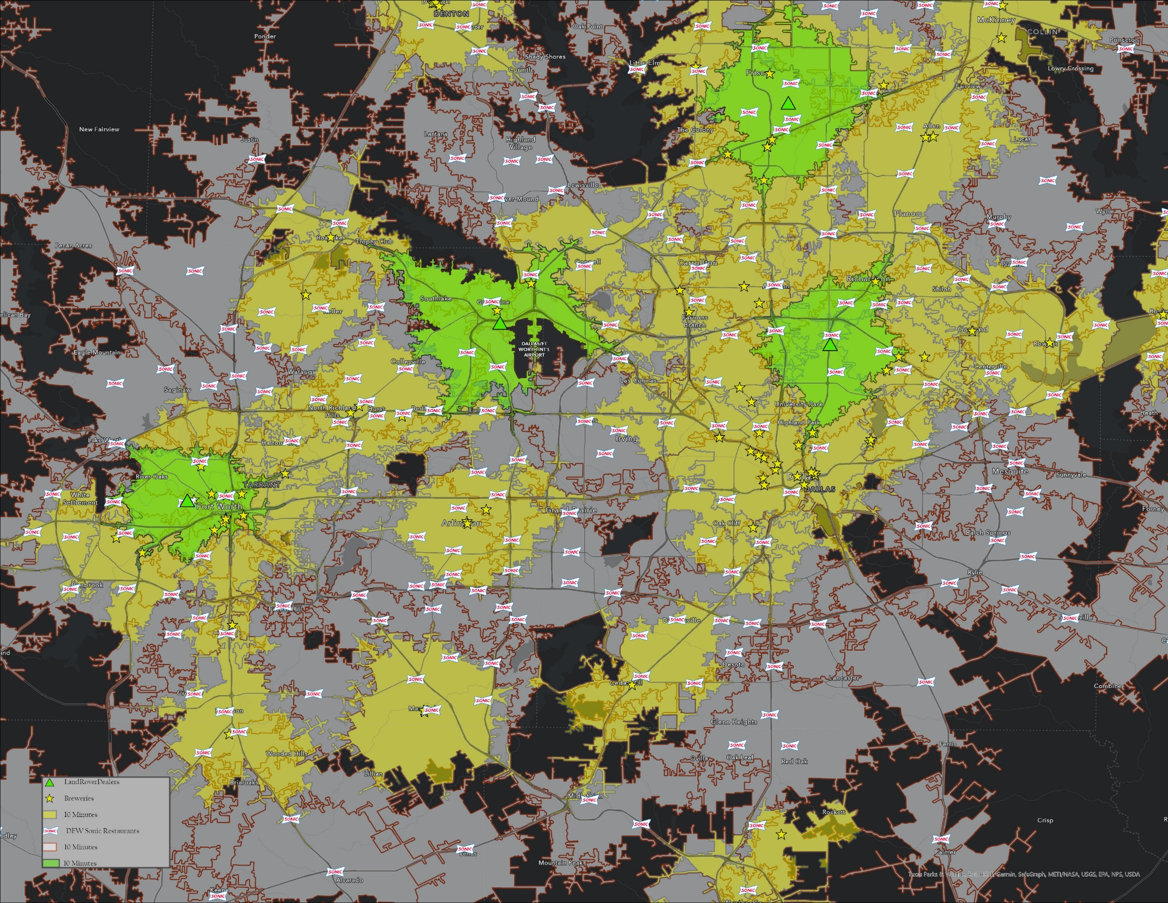

Slide 9
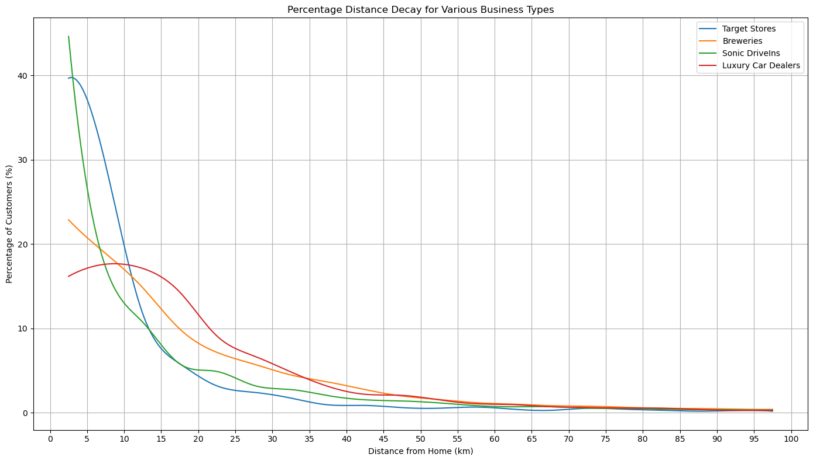
Empirically-derived customer distance-decay functions for the state of Texas, 2022. (Data: Safegraph Patterns, 2022).
Notes:
Safegraph Patterns Data – 2022, Texas.

Slide 10
“Maps are the most important documents in human history. They give us tools to store and exchange knowledge about space and place.”
-Kirk Goldsberry

Slide 11
The Geographic Perspective
More than anything – Geography is a discipline guided by a means of approaching problems and thinking about the world. We call this the “Geographic Perspective”
Applying Geography Everywhere
What’s your major?
Accounting
Pre-law
Interior Design
Dance
Engineering
Geography?

Slide 12
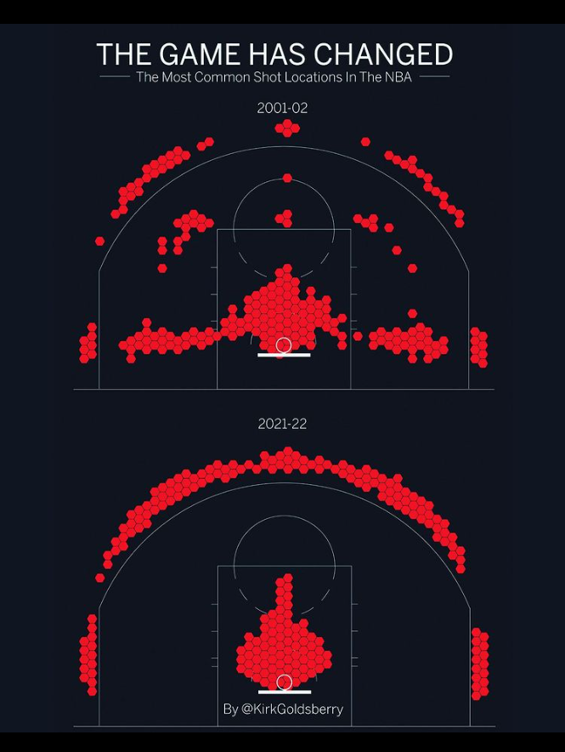

Slide 13
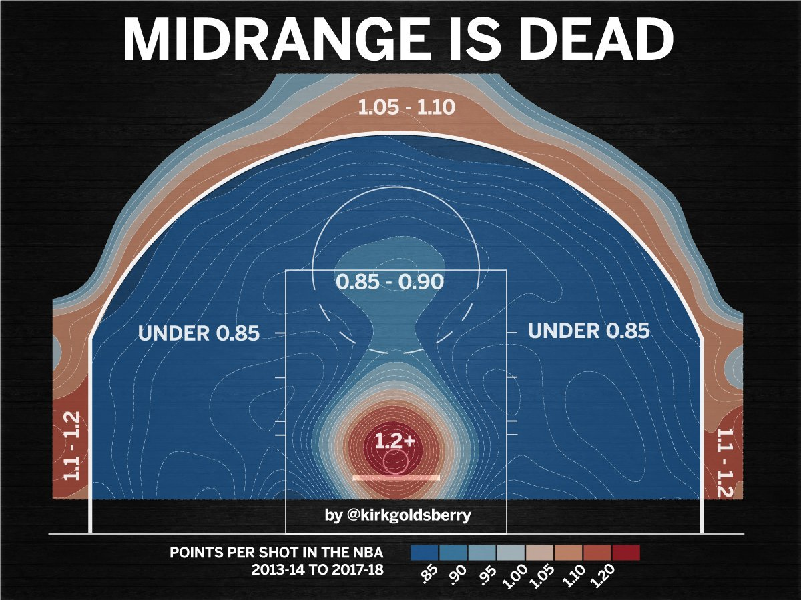
https://twitter.com/kirkgoldsberry/status/1105817076835336192?lang=en

Slide 14
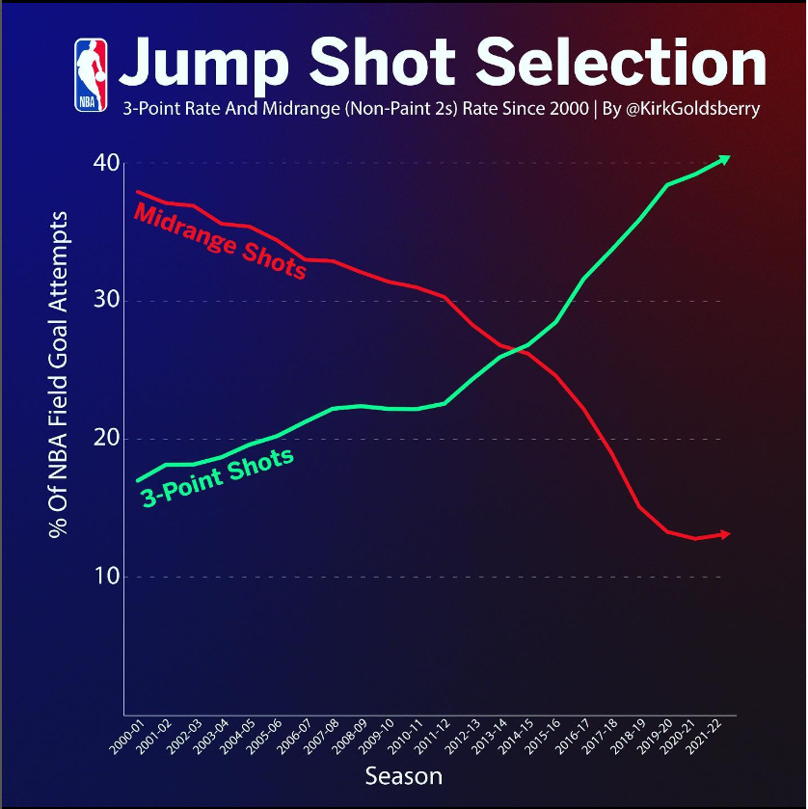

Slide 15
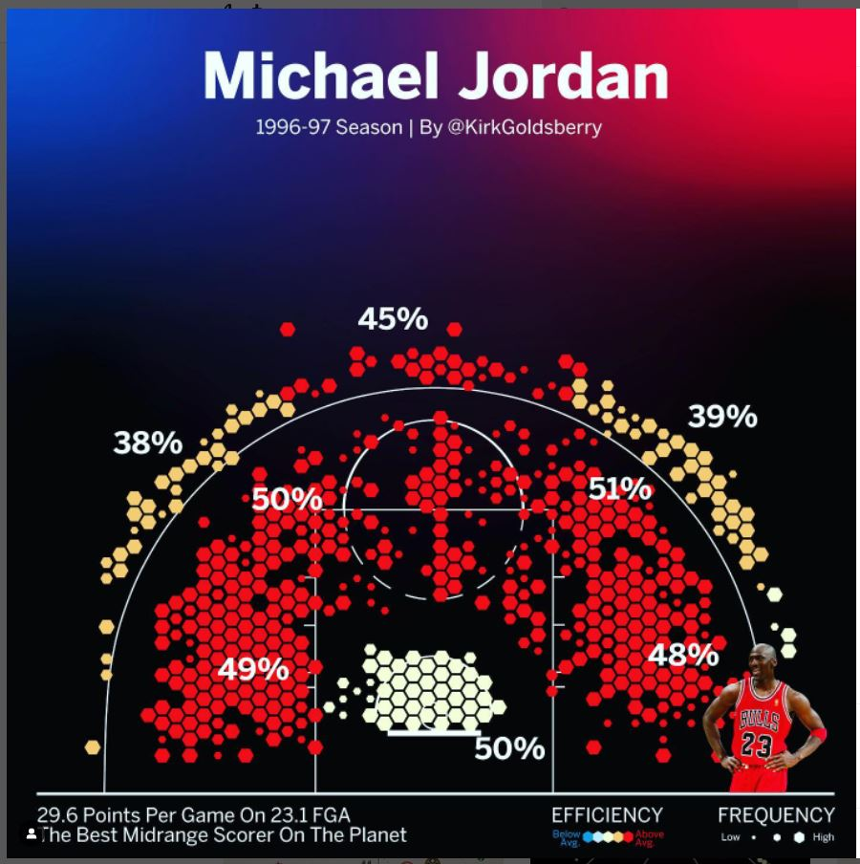
Source

Slide 16
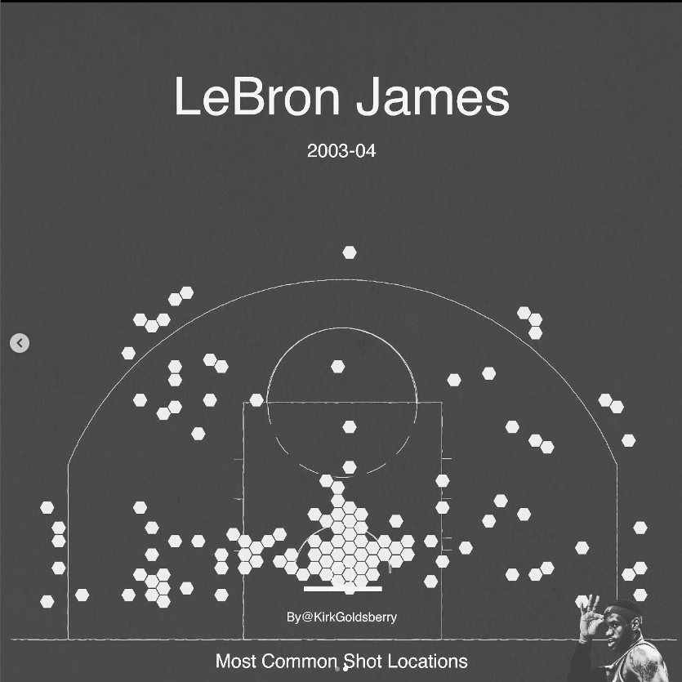

Slide 17
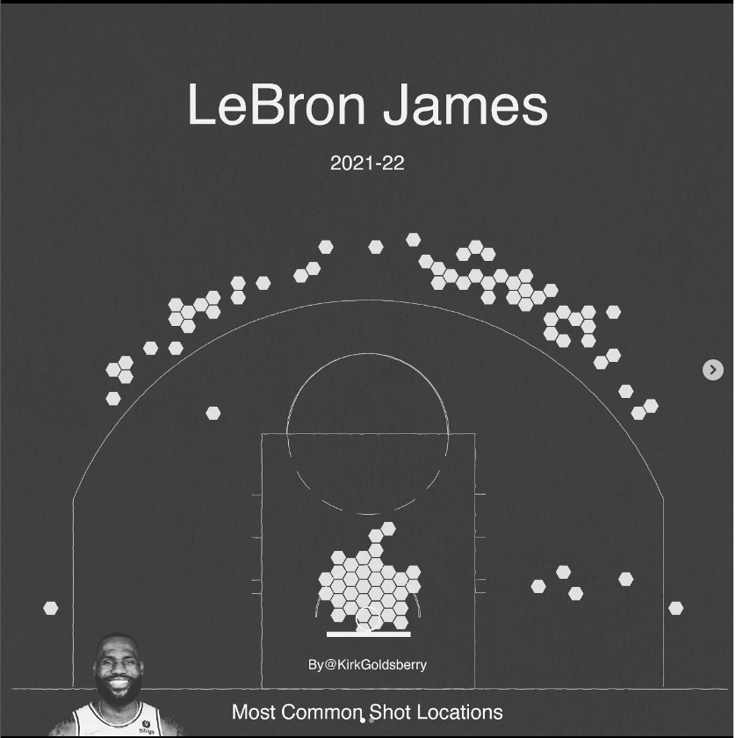

Slide 18
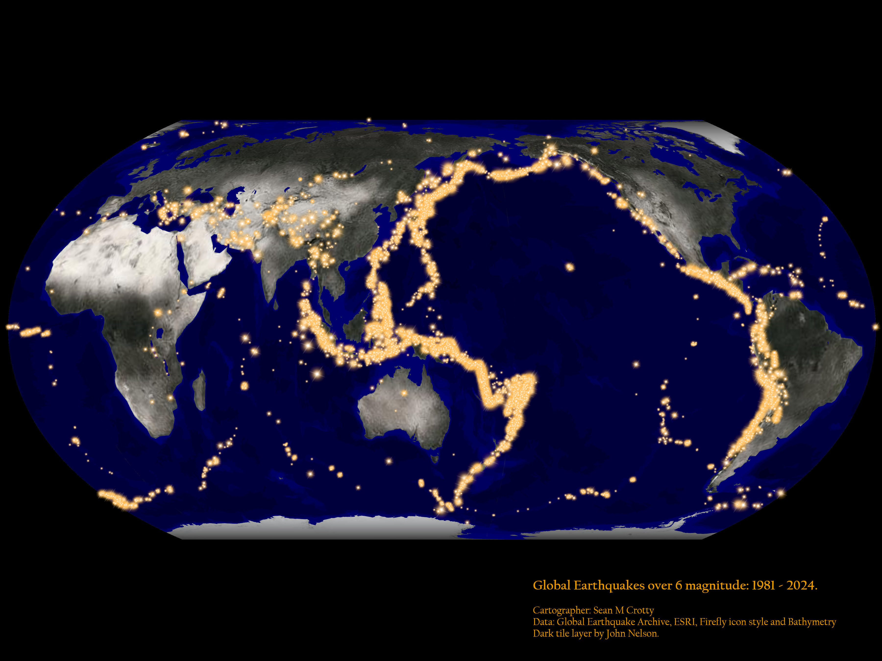

Slide 19
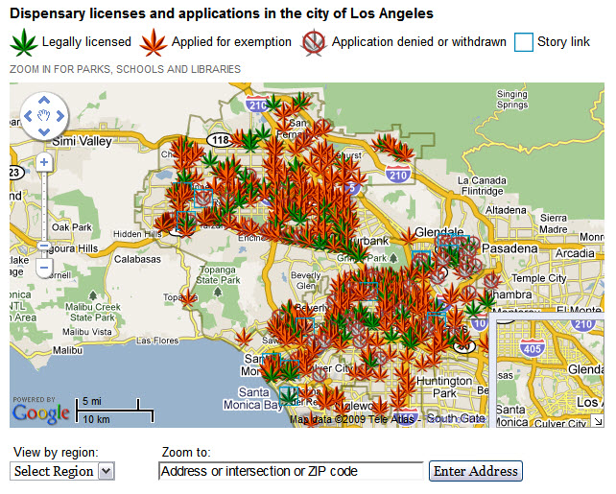
http://latimesblogs.latimes.com/lanow/2009/09/medical-marijuana-in-los-angeles.html
Notes:
Do a few quick Google searches for important things here – Emergency rooms, banks, tornado shelters.

Slide 20



Slide 21
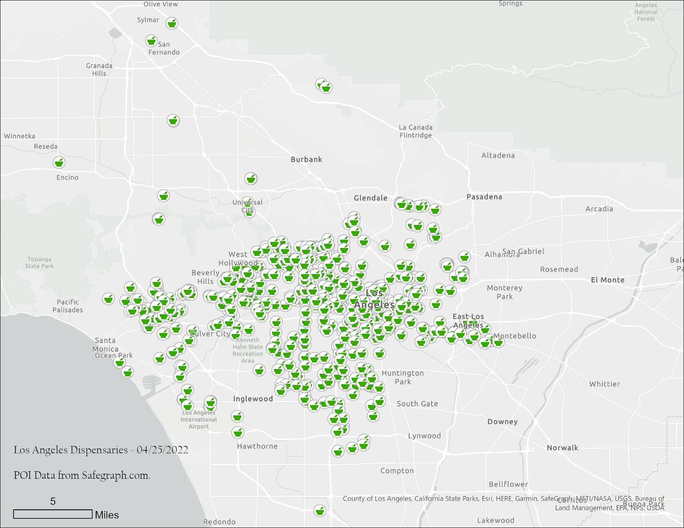

Slide 22
Up next: The Four Pillars of Spatial Thinking

Slide 23
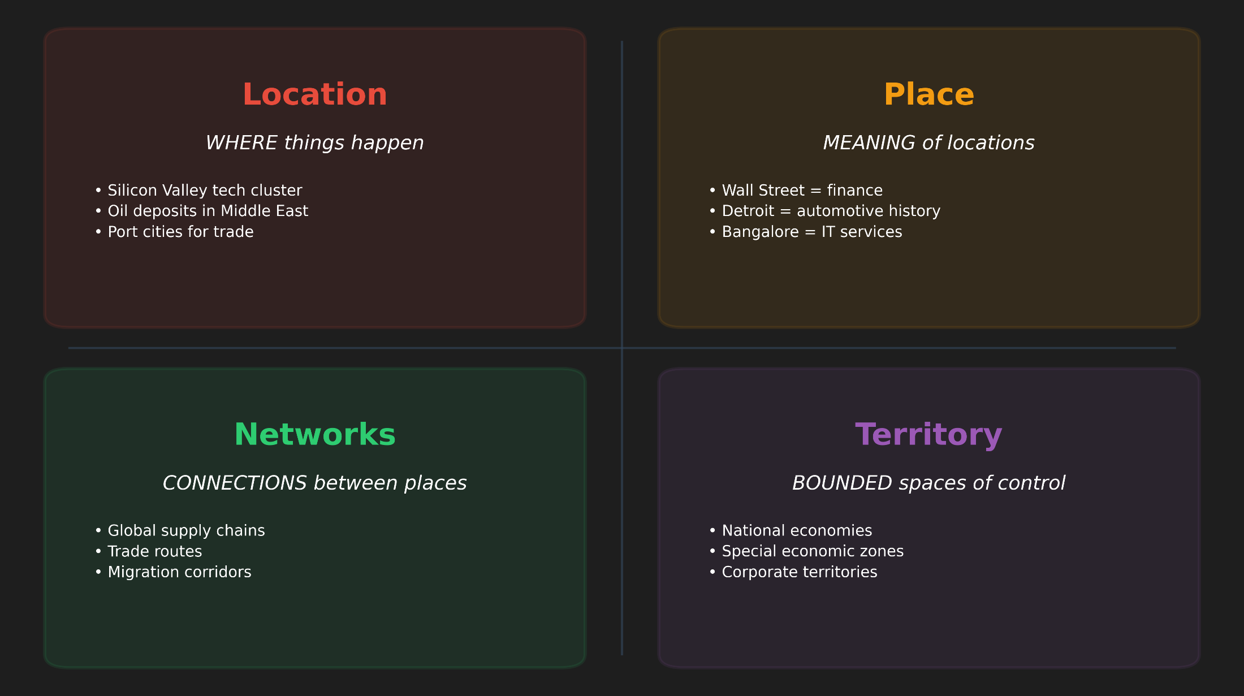
1.2 The Four Pillars of Spatial Thinking

Slide 24
Key concepts of cultural and physical geography: Place
Places provide the setting for people’s daily lives.
They have locations, directionality, and distance with respect to other places.
Have both a physical structure and a cultural content.
Geographers believe that the content of places is explainable (Representation).
It is in these settings that people learn who and what they are (Social Status), how they are connected to differing processes and how they want to behave (Social Roles).
Notes:
Geographers are interested in the social, physical, political, economic, and cultural context from which humans operate. Place matters.
And for many places they Each filling specialized roles in complex and ever changing networks of interaction and change.
Location the meaning of relative and absolute position on the earth’s surface

Slide 25
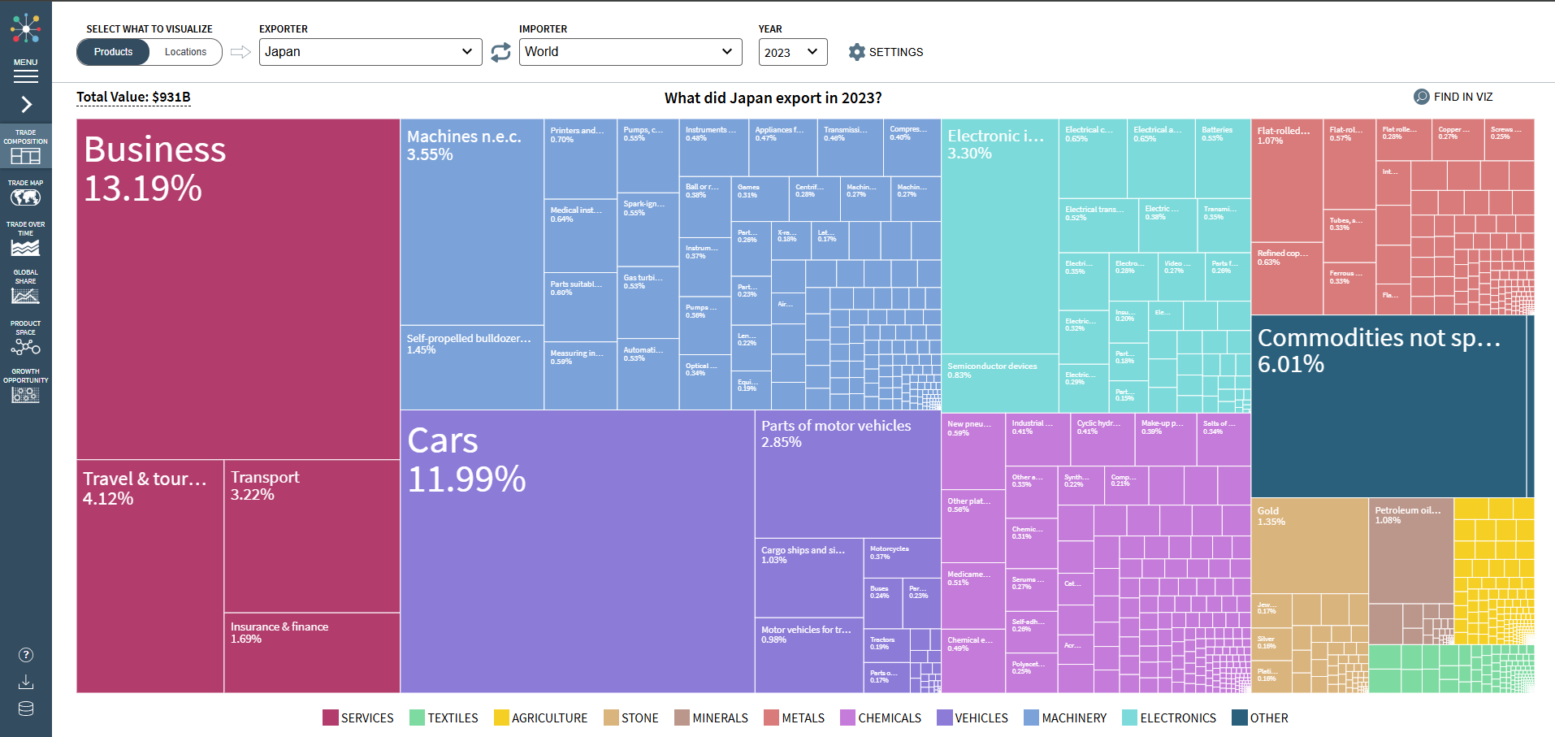
Atlas of Economic Complexity - Harvard University

Slide 26
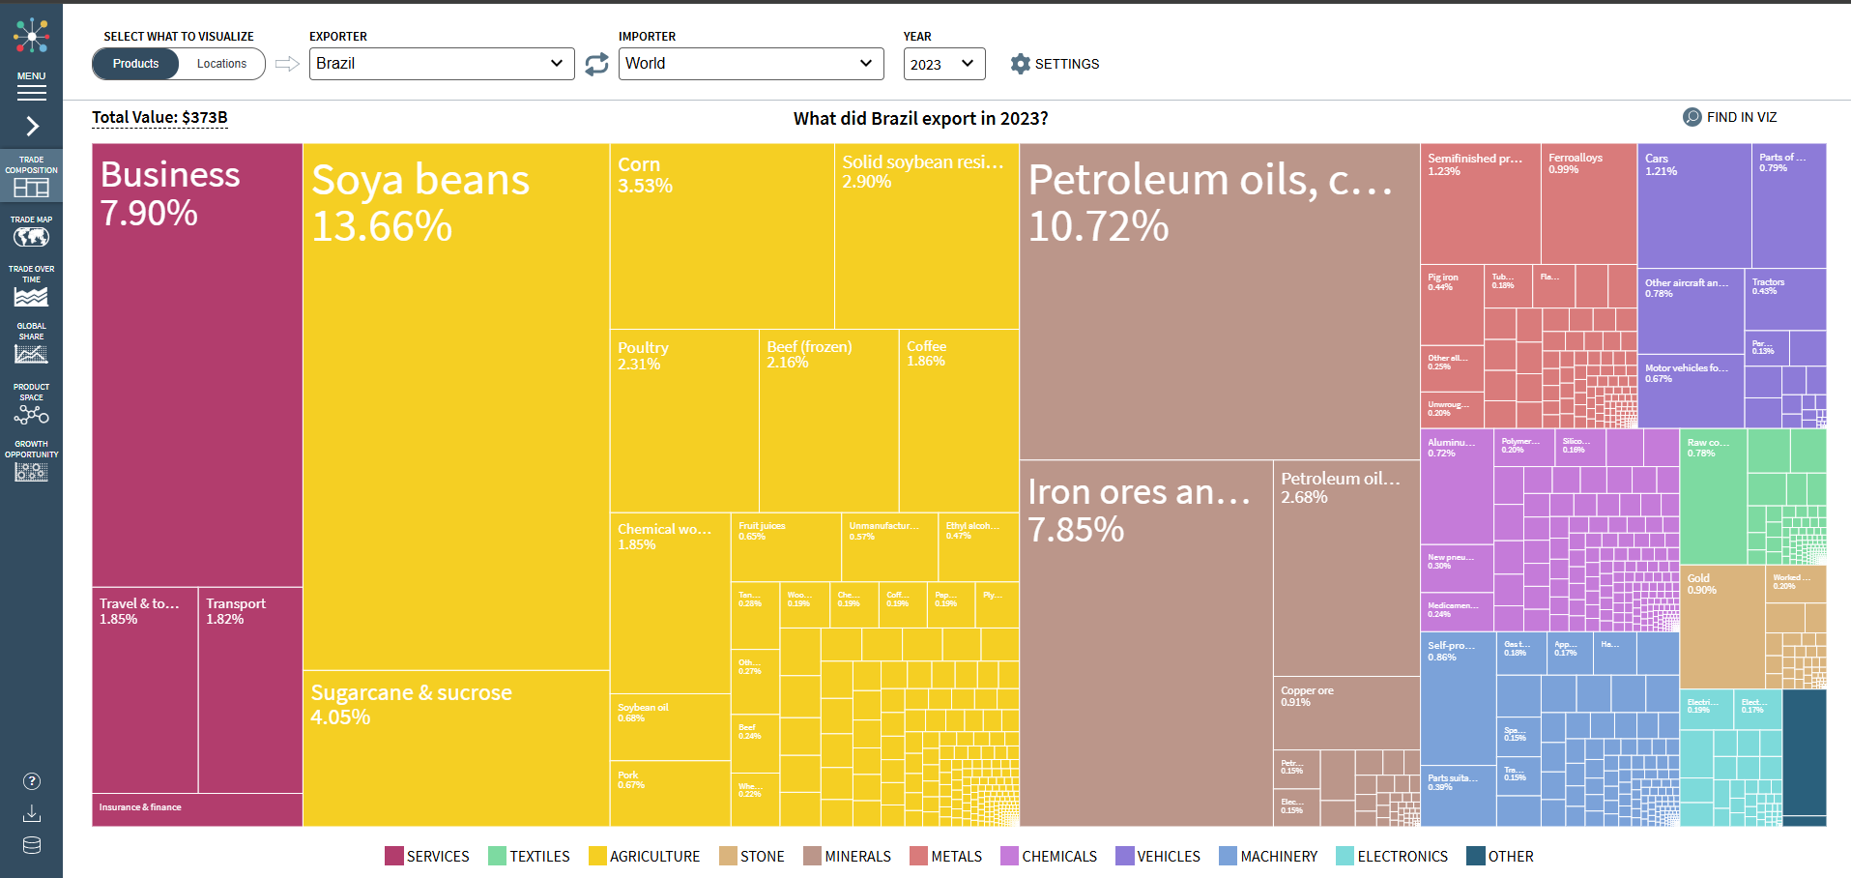
Atlas of Economic Complexity - Harvard University

Slide 27
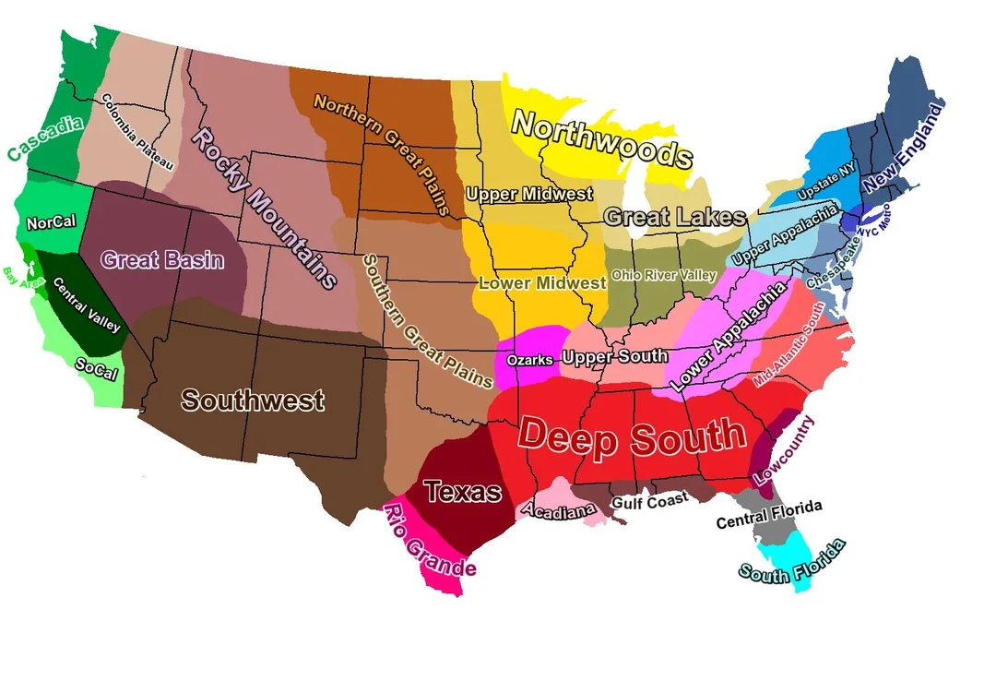
US Culture Regions

Slide 28
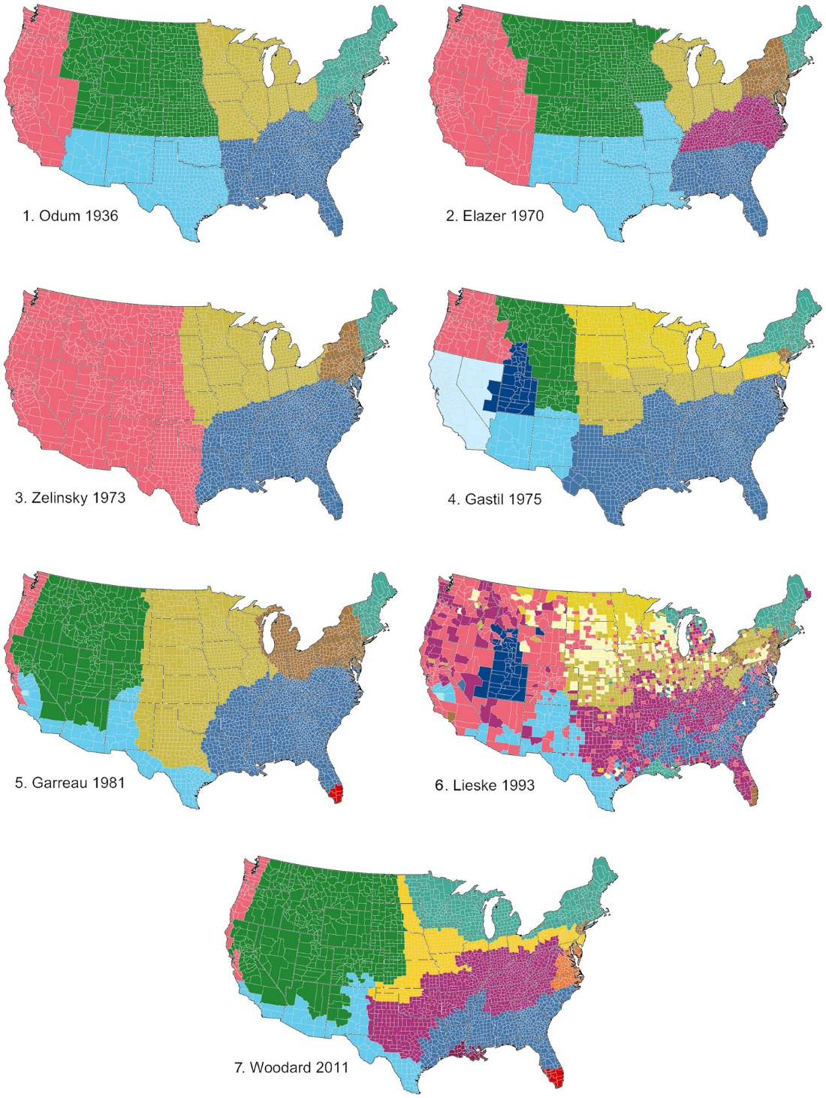
Louf et al 2023
These maps are generated from a compilation of results given in eight previous studies (Elazar, 1970; Garreau, 1996; Gastil, 1975; Lieske, 1993; Odum, 1936; Woodard, 2012; Zelinsky, 1973).

Slide 29
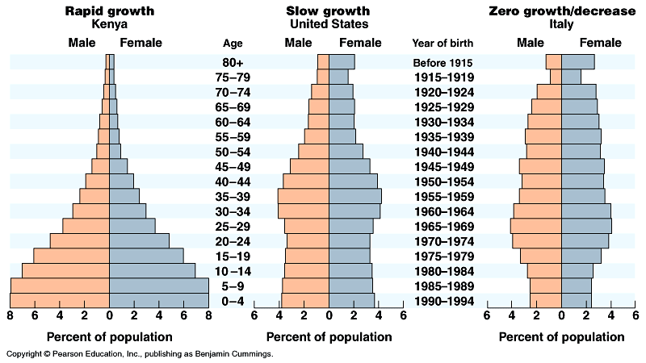
Population Dynamics
Hans Rosling on Global Population Growth
U.S. Census Population Pyramid, 1850 - 2000

Slide 30
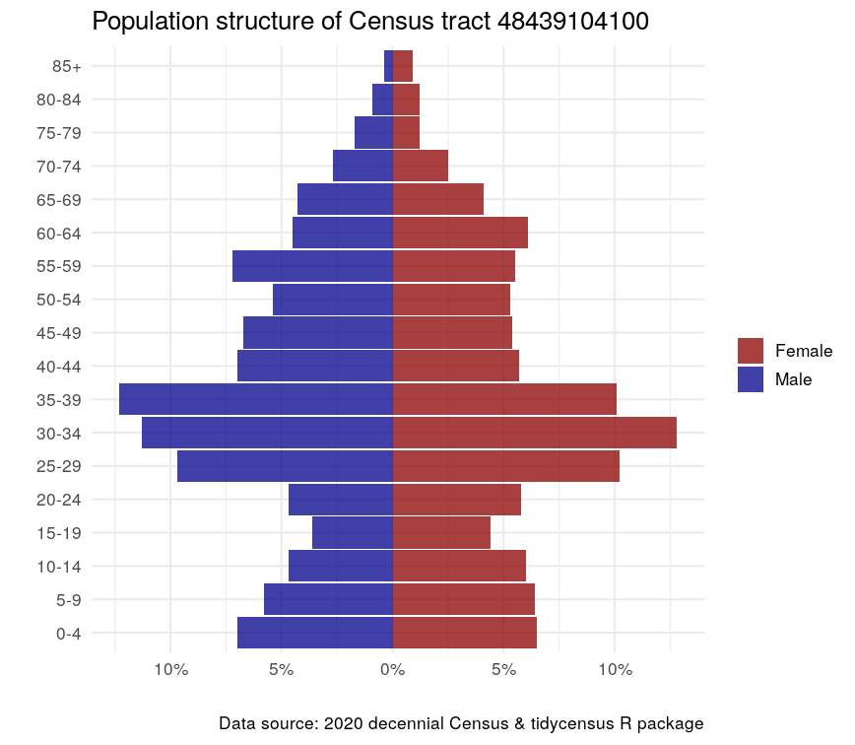
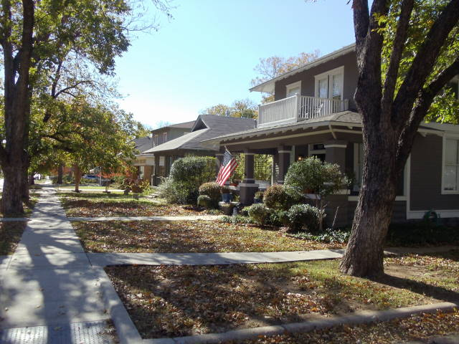
Fairmount, Fort Worth, TX
https://twitter.com/kyle_e_walker/status/1678788839744352258

Slide 31
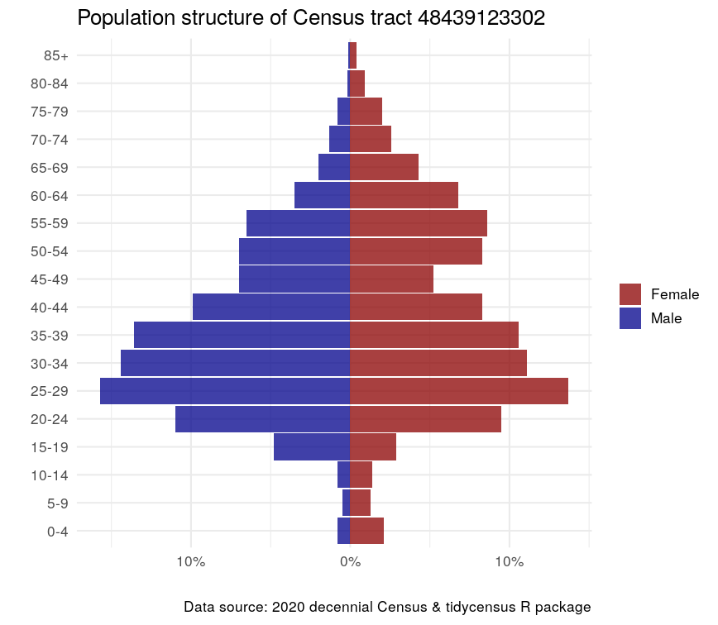
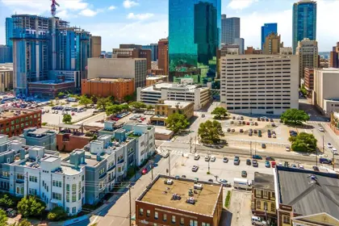
Downtown, Fort Worth, TX

Slide 32
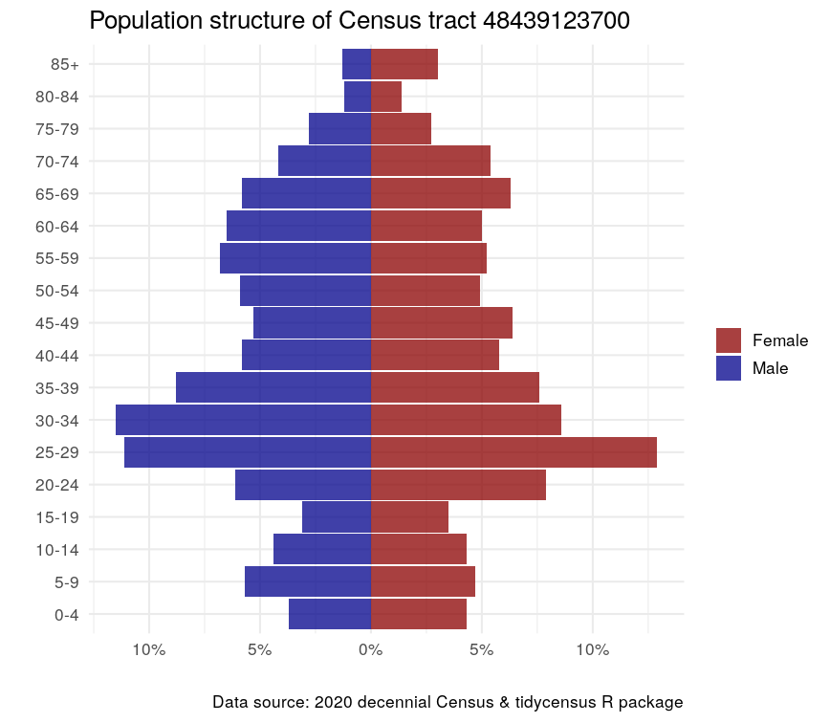
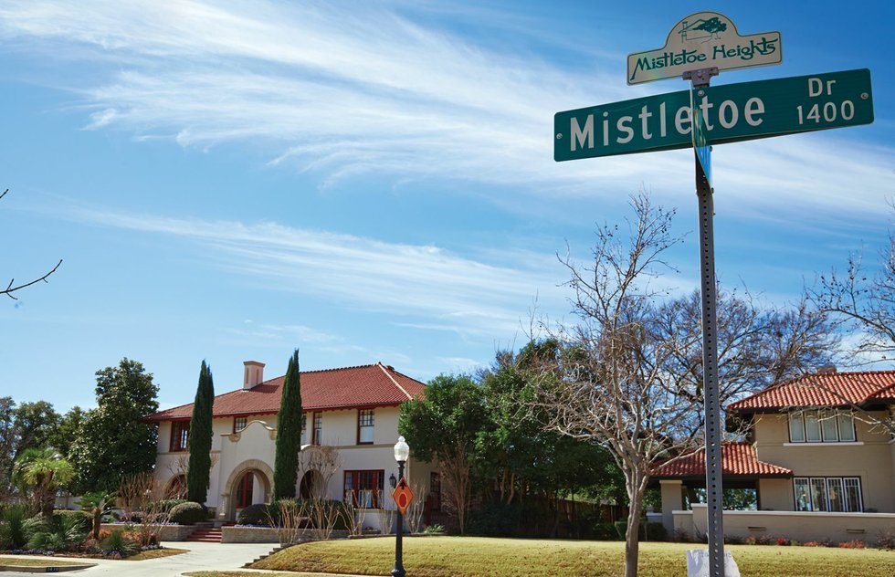
Mistletoe Heights /Medical District, Fort Worth, TX
https://twitter.com/kyle_e_walker/status/1678788839744352258

Slide 33
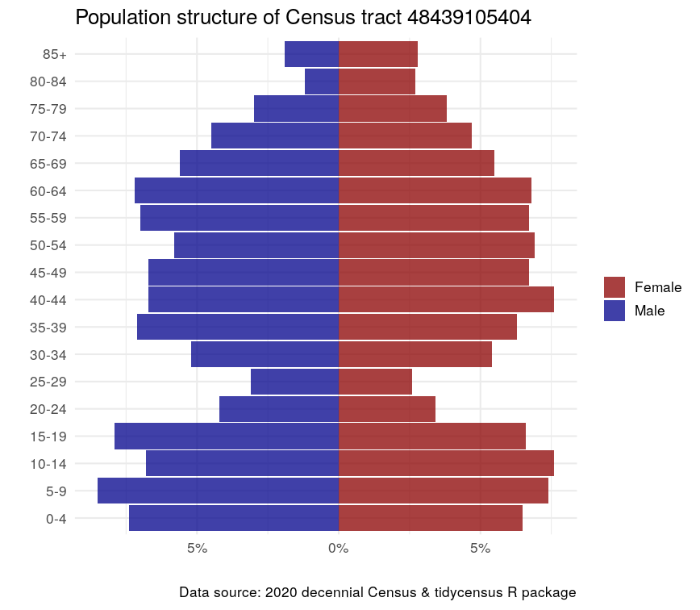
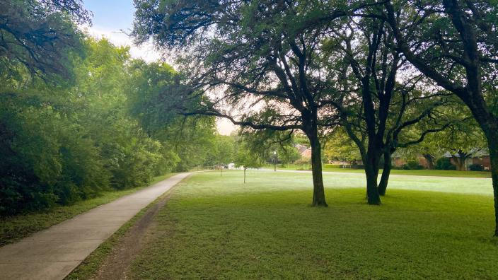
Overton Park/Foster Park, Fort Worth, TX
https://twitter.com/kyle_e_walker/status/1678788839744352258

Slide 34
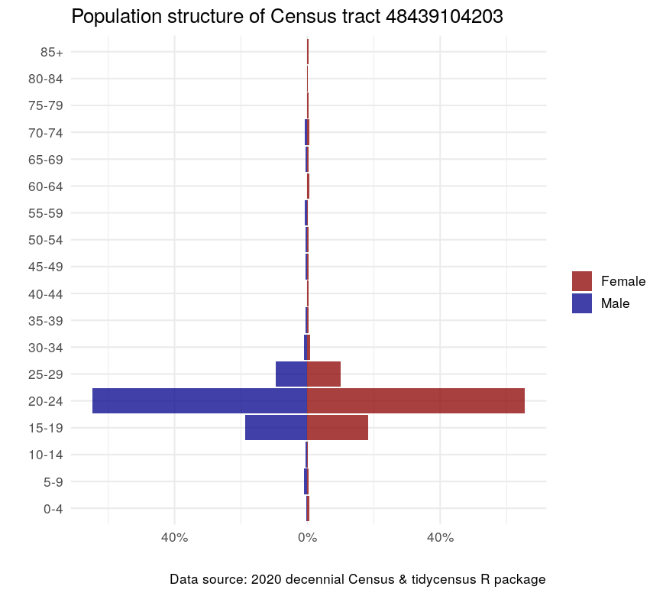
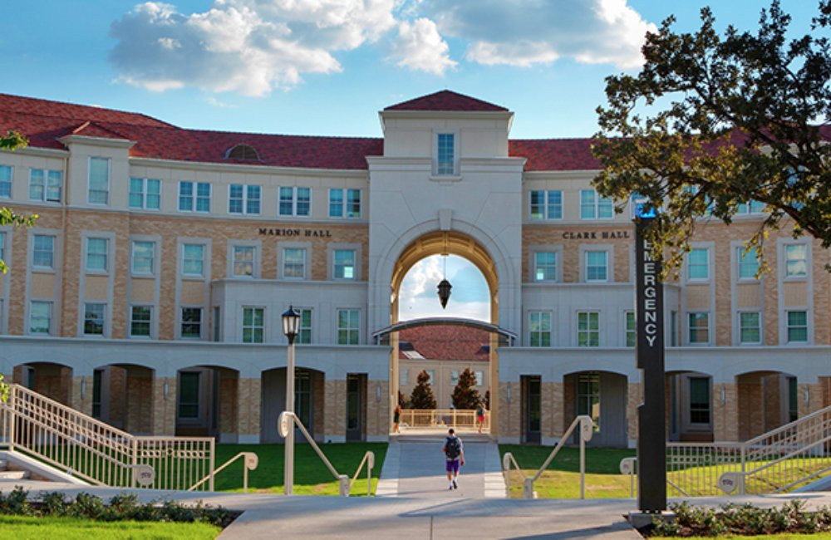
TCU – West Campus

Slide 35
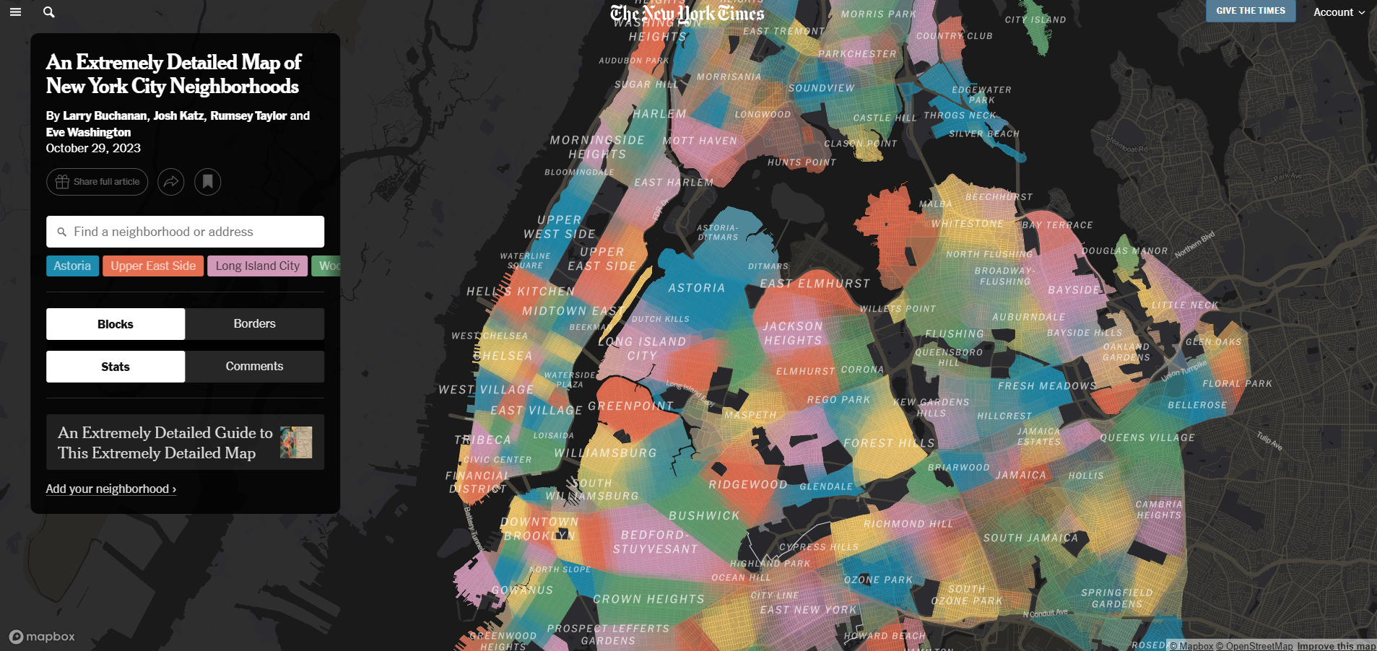
The boundaries of places can shift or even be poorly defined in some cases. The map below shows the names that residents call
https://www.nytimes.com/interactive/2023/upshot/extremely-detailed-nyc-neighborhood-map.html

Slide 36
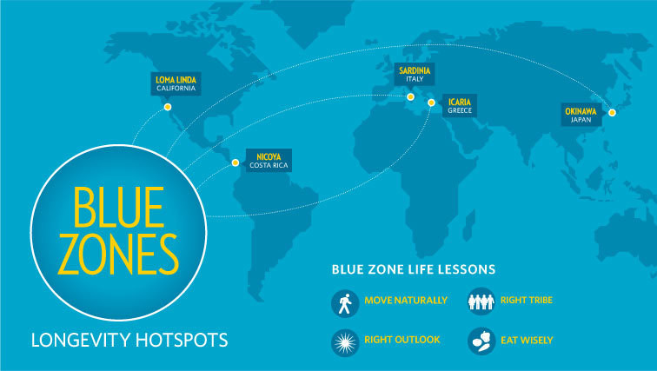

Slide 37
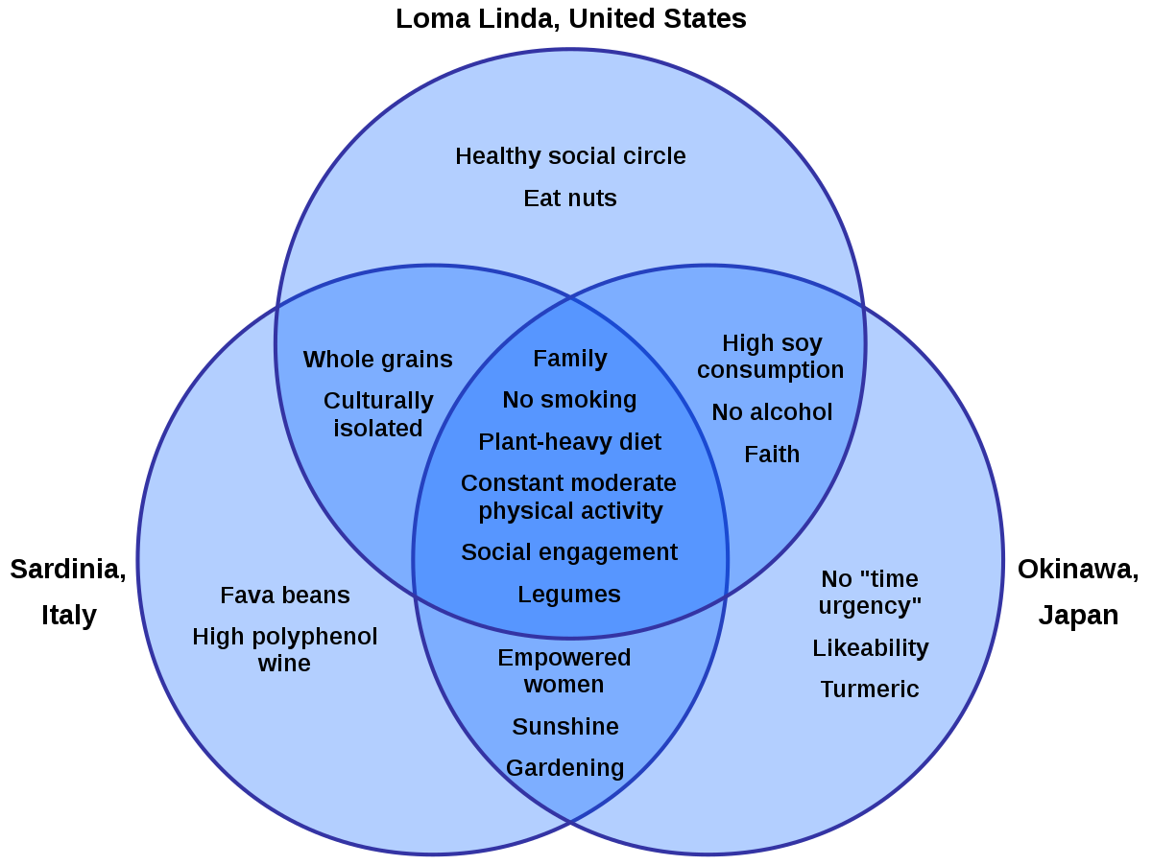

Slide 38



Slide 39
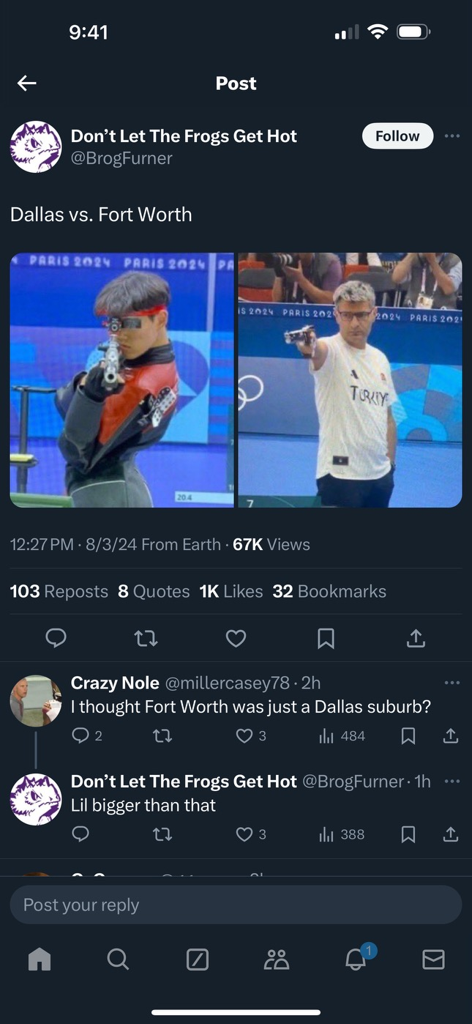

Slide 40

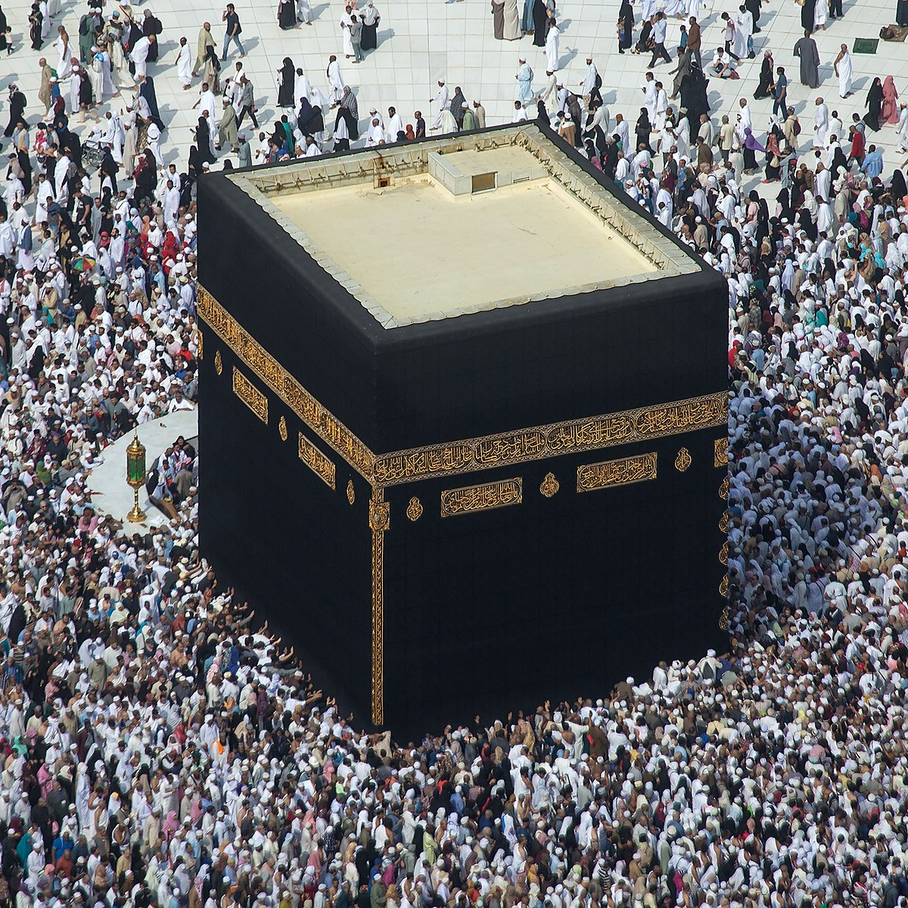

Power of Places
Places acquire strong symbolic value because of the built environment, events, people, or histories with which they are associated.

Slide 41
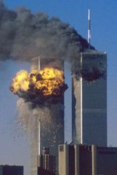
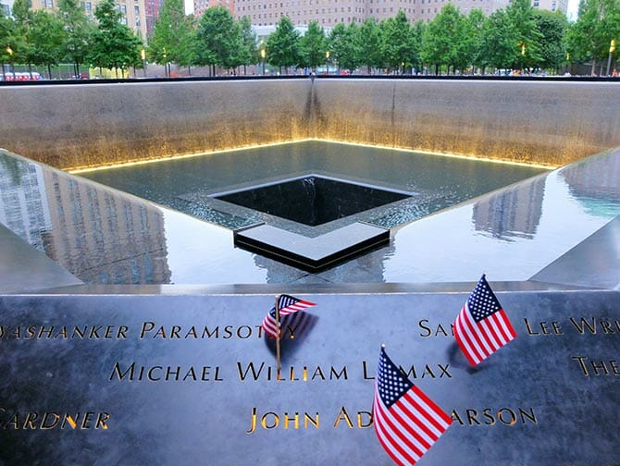

Slide 42
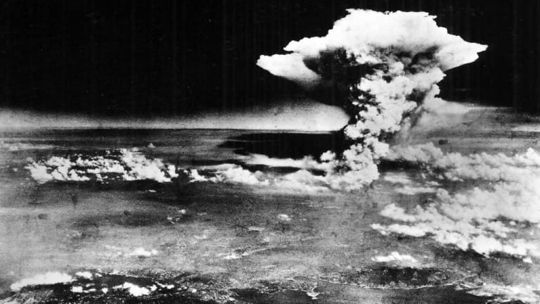
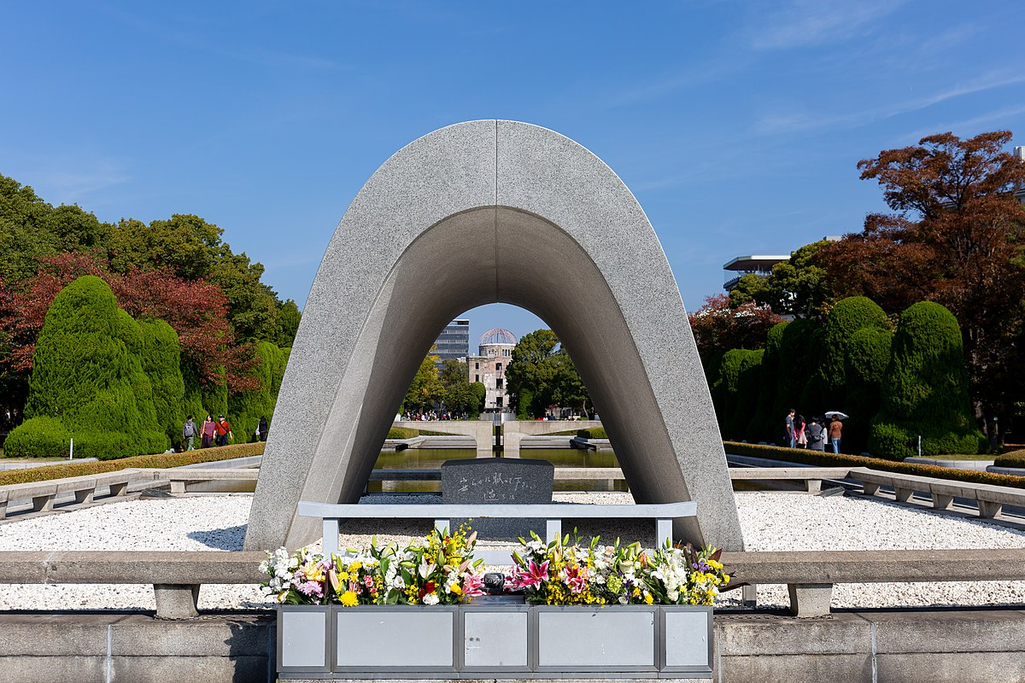
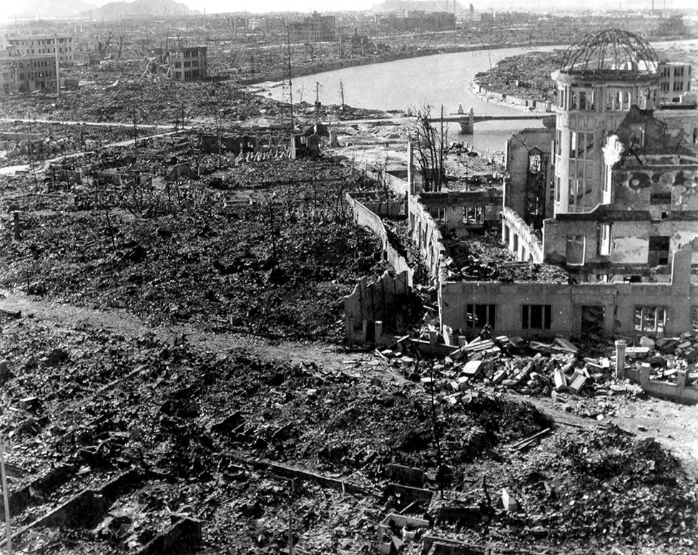

Slide 43
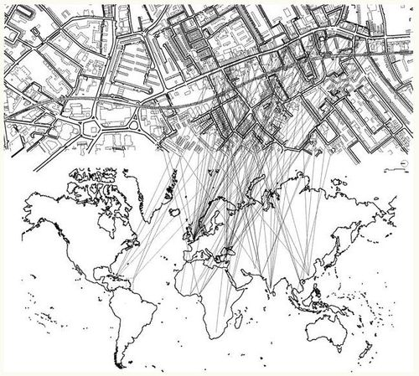
Global Sense of Place
Global interconnection is a precondition for understanding Place.
Places are constituted not by internal characteristics, but rather by linkages to other parts of the world.
Global flows of people, goods, capital, ideas, and cultures.
Place as ‘intersection’ or ‘process’

Slide 44
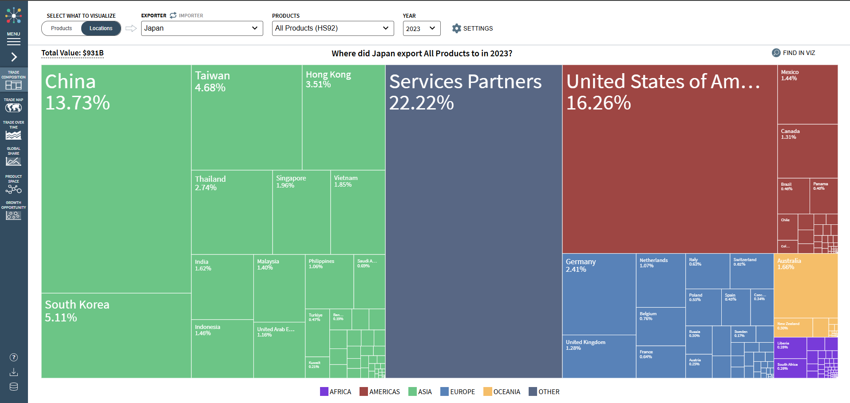
Atlas of Economic Complexity - Harvard University

Slide 45
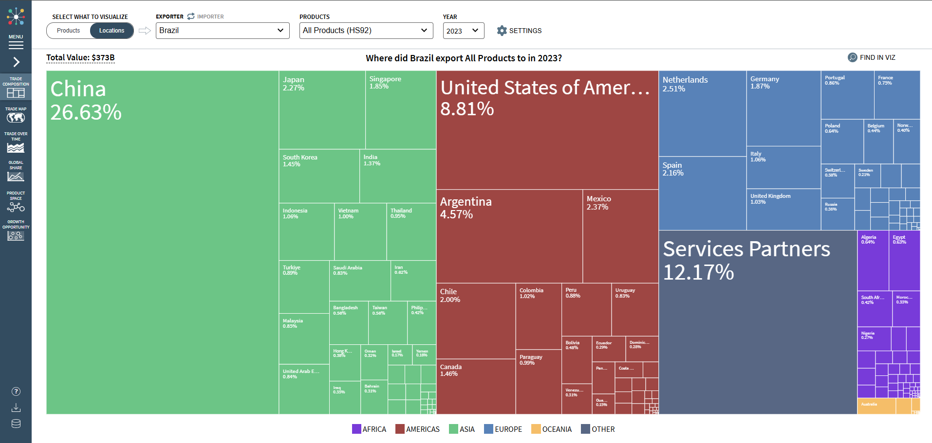
Atlas of Economic Complexity - Harvard University

Slide 46
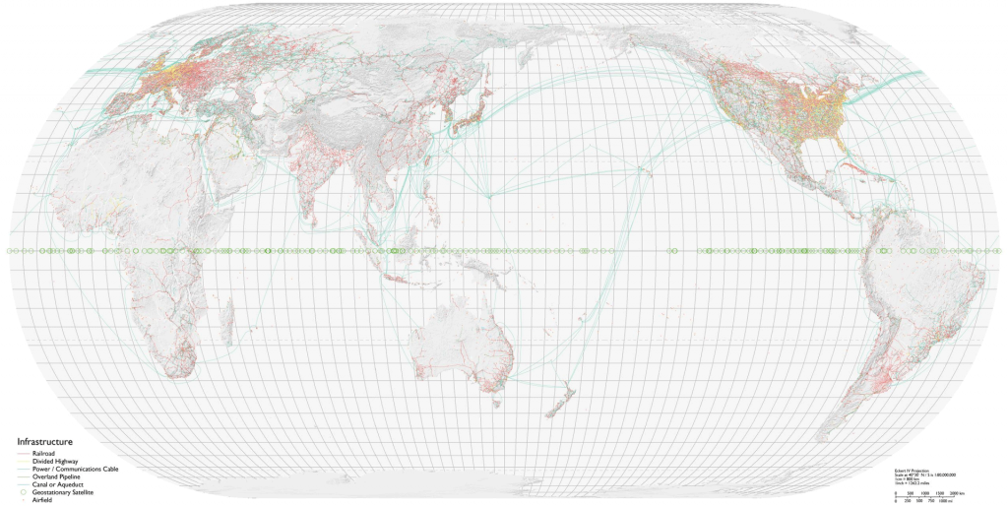
Key concepts of cultural and physical geography: Place & Networks
Places are interdependent
Notes:
Geographers are interested in the social, physical, political, economic, and cultural context from which humans operate. Place matters.
And for many places they Each filling specialized roles in complex and ever changing networks of interaction and change.

Slide 47
Hinterland
Literally means ‘country behind’
A term that applies to the service area ‘behind’ (often surrounding) an urban center
An urban center is the focus of goods and services (often ‘the market’) produced in the hinterland, and is the latter’s dominant focal point as well
Hinterland
Hinterland
City
Notes:
Where is the hinterland of Ft Worth? Where are the goods sold in Ft Worth produced?
(Map of outlying DFW area – then connect to globalisation and networked production.

Slide 48
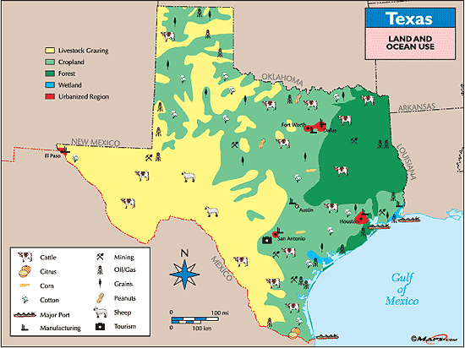

Slide 49
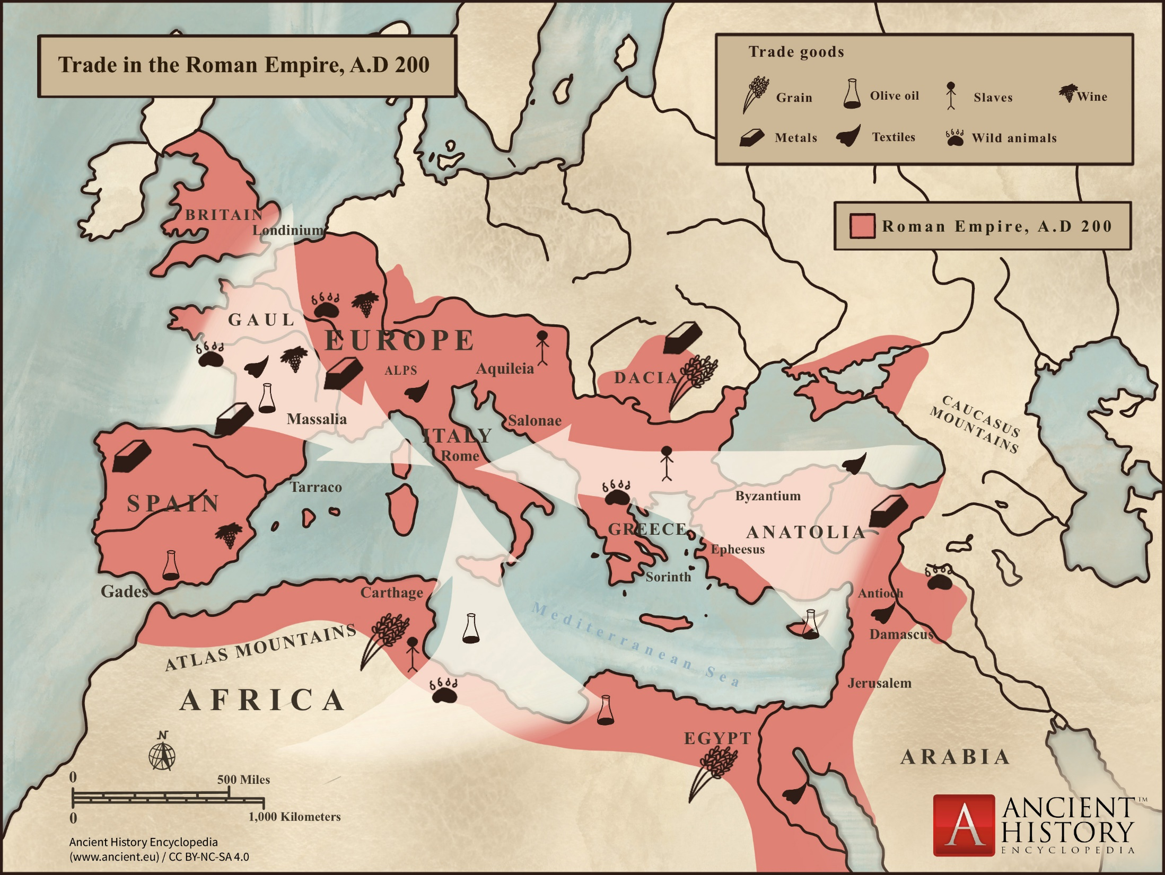
Image Source

Slide 50
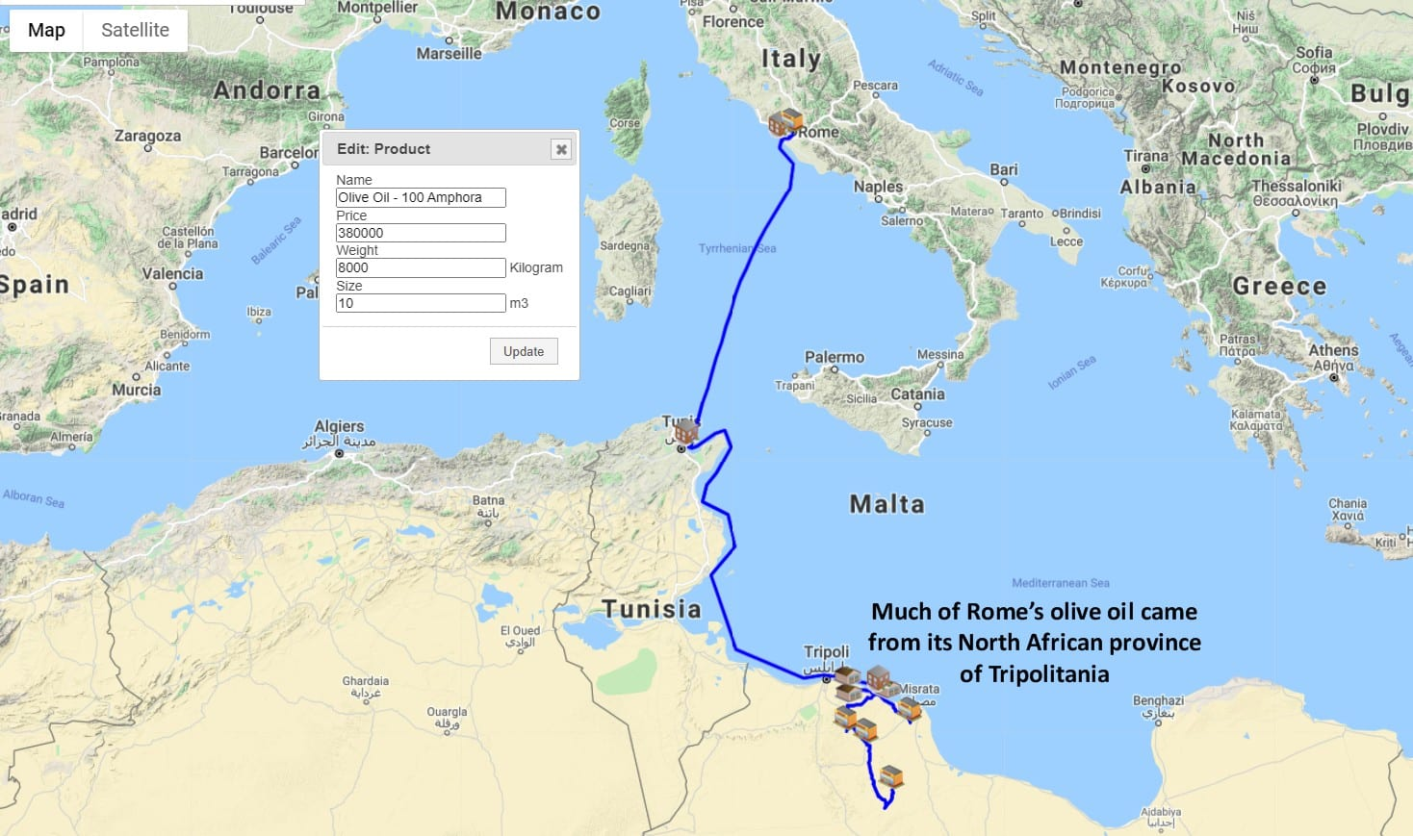
Source: SCMGlobe.com

Slide 51
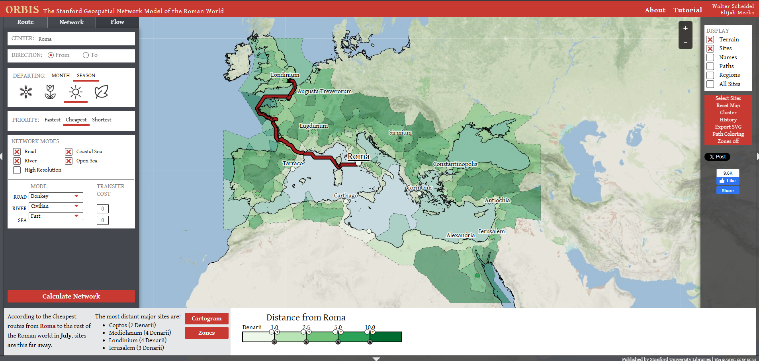
https://orbis.stanford.edu/

Slide 52
https://orbis.stanford.edu/

Slide 53
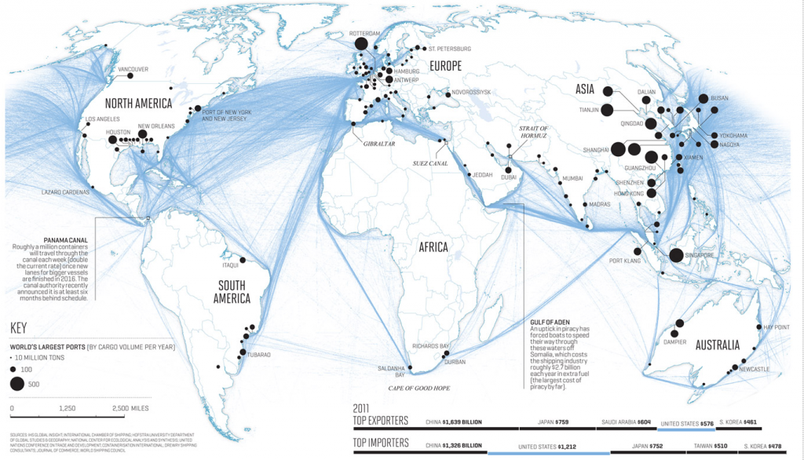
Key concepts of cultural and physical geography: Place & Networks
Places are interdependent
Notes:
Geographers are interested in the social, physical, political, economic, and cultural context from which humans operate. Place matters.
And for many places they Each filling specialized roles in complex and ever changing networks of interaction and change.

Slide 54

Key concepts of cultural and physical geography: Place & Networks
Places are interdependent
Notes:
Geographers are interested in the social, physical, political, economic, and cultural context from which humans operate. Place matters.
And for many places they Each filling specialized roles in complex and ever changing networks of interaction and change.

Slide 55

Hop Production in Pac NW

Slide 57

Source

Slide 58
Up next: Territory
Boundaries, authority, and the production of the spatial economy.

Slide 59


1.4: Territory: Power and Control of Space

Slide 60
State
A politically organized territory
Administered by a sovereign government
Recognized by a significant portion of the international community.
A state must also contain:
a permanent resident population
an organized economy
a functioning internal circulation system

Slide 61
The European Origins of the Modern State
Emergence of the modern state:
Ancient “proto-states” origins
European state model: assumed a political entity (state) would territorially match a cultural entity (nation) as a nation-state
Notion of the modern state is challenged…
“from below” by ethnic minorities/nationalities.
Devolution – e.g. pursuit of independence in Scotland.
“from above” by international integration.
Supranationalism – e.g. multi-state trade agreements
Power is still largely held by states.

Slide 62
Territory and States
States: geographic term for political entities; also known as countries
State boundaries and “nation” boundaries do not always concur. (e.g. Wales, Scotland, Catalonia, Kurdistan)
Sovereignty: notion that the government of a state rules supreme within its borders
Essential to the world’s territory organized into a system of states
Sovereignty is usually recognized by other states.
However, recognition can be influenced by geopolitical considerations: conflicts, resources, history, cultural similarity or difference.

Slide 63


Slide 64

Territory and States
States create laws to regulate (and promote) economic activities in various ways.
States can control flows of goods and labor (people).
The trade barrier index scores countries based on openness to trade. Darker is more open on this map.

Slide 65

States can also encourage trade and investment by defining particular zones within their territorial control, where the rules of economic activity are altered to be more pro-business than is the case for the rest of the territory. The naming conventions for these zones varies depending on the country and specific goals/purposes of the zones.
https://www.openzonemap.com/map

Slide 66

States can also join supra-national organizations that reduce barriers between states. The degree of these barrier reductions vary: some only address particular industries, while others like the EU dramatically increase interconnection between member states – allowing movement of goods and people, as well as creating a common currency.
Map source: “Figure 2.15 Global Groups with the Big Three Core Areas of North America, Western Europe, and Eastern Asia” by Dr. Royal Berglee, CC BY-NC-SA 3.0.

Slide 67
Geography’s Perspective: Scale and Scope
Scale: map or analytical representation
Map scale: compares the area and detail on the ground and on the map
Operational scale: scale where social or natural processes play out and are investigated at a certain level of analysis

Slide 68

Key Geographic Concepts: Scale
Scale
Discursive tool
Levels of analysis
Global
Macro-regional
National
Regional
Local
Lived Places
Economic processes are constituted at multiple scales simultaneously
No scale of analysis is enough to provide comprehensive understanding on its own

Slide 69

Investment zones can be created at multiple scales of territorial control. The map below shows just some of the defined incentive zones within the city of Fort Worth, Texas.
Fort Worth Economic Incentive Zones

Slide 70

Government Spending/Debt
Global Government Debt Map
When does federal government debt reach unsustainable levels - Wharton School

Slide 71

Government Spending/Debt
When does federal government debt reach unsustainable levels - Wharton School
Global Government Debt Map

Slide 72

Informal Economy Map

Slide 73

Source
Map by Evan Centanni and Djordje Djukic, starting from base map by Koen Adams of onestopmap.com. "Neutral Joint Force" has been redefined to exclude Darfuri former rebel groups who have joined the fight against the RSF, now subsumed under "Govt./SAF & allies". See below for a detailed accounting of which groups are included in each territorial control category.

Slide 74


Slide 75

Mexican Cartels Moving into Oil Industry - 2018

Slide 76
Non-state actors can also exert territorial control in ways that have profound effects on economic activities. The map below shows neighborhoods in New York City. Neighborhood organizations have driven tremendous changes in urban housing markets across the United States through organized opposition to new/multifamily housing proposals.
Excluded: How snob zoning, NIMBYism, and Class Bias Build the Walls We Don't See
NYC Neighborhoods Map
Not-just NIMBYism to blame for housing crisis

Slide 77
Up next: What is “the Economy”?

